Slide 1



Summer EBT
SY 2025-2026
Lynne A. Fellin, SNS
Associate Director, SCNP
1
Notes:
Good afternoon, and welcome. I’m Lynne Fellin and this is the background and data reporting webinar for Summer EBT SY 2025-2026. Thank you for being here. Whatever your role is in the LEA related to student data, eligibility, and Summer EBT, it’s an important one and we appreciate your participation. Also on the webinar today we have members of the DOE SEBT Team including Carol Wells Bazzichi, Director of Data Services, Dave Hanzlik, IT Business Process Development Team Leader, Ron Parrish from the Office of Data Governance, and Tim Roesch, Technology contractor for the School and Community Nutrition Programs. All have been essential in the creation of this new way to collect LEA data for SEBT, and I personally thank them for their work.
The supporting documents and slide deck will be posted to the Data Collections page of the Data Services website and will be uploaded to the chat at each section of the webinar. A recording of the webinar content will be posted to the VDOE YouTube channel when ready. Other LEA communications will be distributed to the Data Stewards in the weekly Tuesday Telegram and to SNP administrators via the SCNP memo and weekly DOE Education Update.

Slide 2






AGENDA
Background and Purpose
Student Eligibility
Collection Cycle and Responsibilities
Eligible Student Data File Elements and Process
Communications
Questions
Notes:
This Summer EBT SY 2025-2026 webinar will share information on Virginia’s plan for implementation including details on process and responsibilities, student eligibility, SSWS data collection, eligible student file, resources for LEAs, and household communications and readiness plan. When we use the term LEA it means the local education agency participating in the NSLP, whether it’s a public school division or a non-public, non-profit school.
This webinar was designed to provide answers to questions you may have been thinking about already. Please record your questions as we go through the content. There will be an opportunity at the end to ask questions if they remain unanswered by the webinar content.

Slide 3
SEBT Eligible Student Collection
BACKGROUND AND PURPOSE

Slide 4

Background
The Consolidated Appropriations Act, 2023 (PL 117-328) authorized a permanent, nationwide Summer Electronic Benefits Transfer (SEBT) program beginning in 2024
In Virginia, this program is known to households as Virginia SUN Bucks
Eligible children will receive $120 via EBT card to purchase groceries in Summer 2026.
Over 1.25 million children in Virginia received SUN Bucks since 2024
More than $150 million has been added to Virginia’s economy by SEBT
Your work makes a difference!
Notes:
Formally known as the Summer EBT program, and known to households and the public as SUN Bucks, this permanent USDA program is a summer grocery benefit for families of eligible school-aged children.
The lead agency for Virginia SUN Bucks is the Virginia Department of Social Services, with responsibility for management and issuance of benefits.. VDOE, local school divisions and private schools are partners with VDSS and play key roles as streamlined data providers and direct communication channels to households.
In the first two years of SUN Bucks, more than 1.25 million school-aged children received the benefit with more than $150 million added to Virginia’s economy through grocery and farmers market purchases.

Slide 5
The Summer EBT Eligible Student Collection was created to….
Streamline Student Access to Nutrition Support
Notes:
The Summer EBT Eligible Student Collection was created to:
Streamline data collection, align with VDOE data collections
This is your data story.
Your data story is read by others, and as it is read, decisions are made on a local, state-wide, and even federal level. There are so many others who need your datasets including parents, taxpayers, other school divisions, and companies, to name a few.

Slide 6

Purpose
Provide existing student data for issuing SEBT grocery benefits to support students and households when school meals are not available.
Decrease summer learning loss.
Eliminate separate SEBT eligibility applications and LEA approval process for this new federal nutrition program.
Create a VDOE SSWS application for the SEBT data collection to align with other VDOE collections, processes, terminology and support.

Slide 7

Data Submitted to VDOE via SSWS
SEBT Eligible Student Data Collection
  New SEBT Application in SSWS
  Aligns with other VDOE data collections
    SSWS role assignments
    Format
    Tab delimited flat file
    Record types
    SSWS role assignments,
    VDOE terminology
    Supporting documents, and Help modeled after other SSWS collections.
In response to LEA needs….

Slide 8
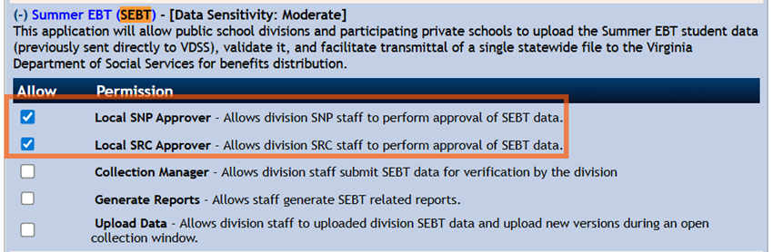
SSWS Permissions
Contact: Local SSWS Account Manager or Back-up Acct Mgr
SSWS Main->ERA ->Staff Details->Update Permissions
Notes:
Access to the Application
Contact your local SSWS Account or back-up Account Manager if you need assistance with the following:
1. Assigning the SEBT application contact in ERA
a) This is critical for VDOE to contact the correct person with important updates
2. Determining rights and privileges to the SEBT application
a) This includes setting up the SEBT collection managers, local approvers, and rights to submit the data or access reports
3. Establishing Superintendent Data Collection Approval (SDCA) account for Superintendent or Director

Slide 9
SEBT Responsibilities
LEA Data Stewards
  SME in student information system, student data, VDOE data collections
  Student Information Validator
  SRC Approver
LEA School Nutrition Program Administrator
  SME in school nutrition programs, Summer EBT requirements, student eligibility
  Individual Student Free and Reduced-price Eligibility Provider
  SNP Approver
SEBT Collection Manager
  Monitor progress of SEBT data collection in SSWS application, including deadlines
Division Superintendent
  Final Verification Approval for Submission
Notes:
Responsibilities of various SEBT partners in each LEA. This is an LEA data collection, not a school nutrition program collection.
It requires leadership and file development by the data stewards to align with other student data submitted to DOE, such as the SRC.

Slide 10
Student Eligibility for Summer EBT

Slide 11

Who Will Receive the Benefit?
Children who applied for and receive any of the benefits listed below:
  Supplemental Nutrition Assistance Program (SNAP)
  Temporary Assistance for Needy Families (TANF)
  Medicaid Income Eligible Free or Reduced-Price
  Categorical Eligibility: Homeless, Head Start, etc.
  Free or Reduced-Price Meal Application
Students enrolled in an NSLP school who are not determined eligible by one of these methods will have an alternative way to apply for SEBT through the VDSS.
Notes:
To be automatically eligible for SUN Bucks, a student must have an individual free or reduced-price eligibility determination by the LEA during the SEBT school year.
Eligible F/R students are called “streamline certified” meaning they don’t need to submit additional information to be eligible for SEBT – they are already certified for F/R meals.
These streamline certified students are the only students eligible for SEBT.
There are two requirements for a student to be eligible for SEBT:
Students who attend in person a school that participates in the National School Lunch Program and have been determined eligible for free or reduced-price meals by any of the methods listed are automatically eligible for SEBT and must be included in your SEBT file to receive the benefit from VDSS.
Students who attend an NSLP school but do not have an individual eligibility determination for free and reduced-price meals are not automatically eligible for SEBT or part of the LEA’s SEBT eligible student data collection. If the student is part of a low-income household, the household should apply through the SEBT application process managed by VDSS. More on that will be shared in the Communications section. Question: Who in the LEA would be the resource for the student free and reduced-price eligibility?

Slide 12

Student Eligibility
CEP Schools
Non-CEP Schools
Students determined free eligible (identified students)
  Free by direct certification
  Free by categorical eligibility
    Homeless, migrant, runaway, foster care, and certain Head Start
Students determined reduced-price eligible
  Reduced-price by direct certification (Medicaid Reduced-price)
Students determined free or reduced-price eligible
  Direct certification – free and reduced-price
  Free categorical eligibility
  Meal applications – free and reduced-price by income or case number
Data Source: School Nutrition Program Free and Reduced-price Eligibility Software
Notes:
What is individual student free or reduced-price eligibility?
NSLP eligibility data IS Summer EBT eligibility data. Streamline certification means NSLP eligibility data already determined by the LEA is used for SEBT – LEAs do not collect new applications or make separate eligibility determinations for Summer EBT.
The source of student eligibility for your LEA is the school nutrition program free and reduced-price eligibility report from the software used by the school nutrition program. SNP administrators will be responsible for providing the list of free and reduced-price eligible students to the LEA data stewards for creating and submitting the SEBT Data File.
What is a CEP school? Are any of my schools CEP? Reach out to the SNP administrator or check the publicly posted NSLP Free and Reduced-price Eligibility Report on the DOE website, SCNP Data and Statistics page. https://www.doe.virginia.gov/programs-services/school-operations-support-services/school-nutrition/program-statistics-reports
For CEP schools, the SNP F/R eligibility list should include the identified FREE students (same as CEP ISP) PLUS the reduced-price Medicaid DC eligible students. Schools that do not participate in CEP will use the same information PLUS students approved F or RP eligible by meal applications. Student F/R eligibility for both CEP and traditional student payment schools (non-CEP) is the SAME with only one addition for non-CEP schools, meal application eligibility.
Whether a student attends a CEP school or a non-CEP school, they must be determined eligible in SNP F/R eligibility software to be reported in the LEA SEBT file.
CEP schools will also have students from low-income households who do not receive SNAP, TANF or any of the other automatic eligibility benefits Those households must apply to VDSS with an SEBT application to be determined eligible for SEBT. Non-CEP schools may also have students who did not apply for F/R NSLP meals that should also apply to VDSS for SEBT. The process for households to apply is outlined in the Communications section of the webinar.

Slide 13
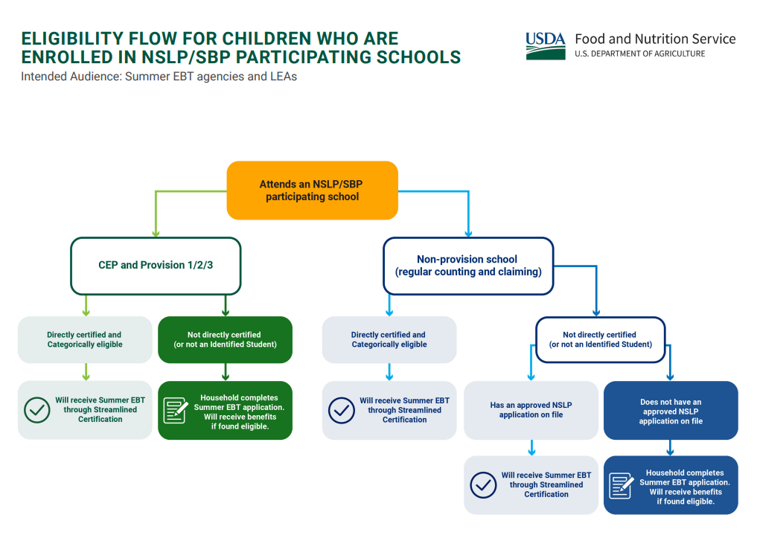



CEP
vs.
Non-CEP
Notes:
This USDA decision tree shows the eligibility flow for children who are attending an NSLP participating school –
CEP/Provision schools are shown on the left and Non-CEP schools are shown on the right. In both cases, students who have a direct certification eligibility are eligible for free or reduced-price meals and are included in eligibility data. LEAs submit the information for those student in the SEBT file – they are shown with the checkmark in the green ovals. Non-CEP schools add F/R eligible application students to their SEBT data files.
Students who attend an NSLP school and are not already NSLP F/R eligible are not in the existing eligibility data and not included in the LEA file - they may apply for Summer SBT through an application managed by VDSS.
CEP families will benefit from LEA support and help to be aware and understand their options to apply for SEBT if required.

Slide 14
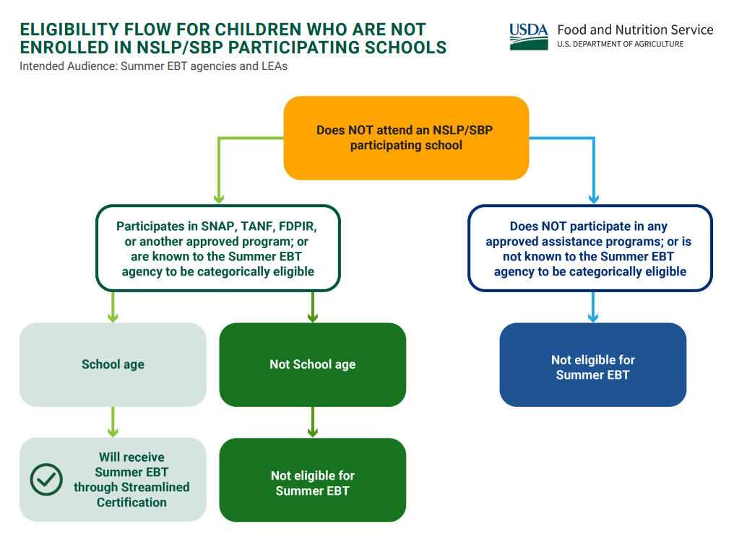

Not enrolled or attending an NSLP School
Notes:
This USDA decision tree shows the SEBT eligibility flow for children who do not attend a school that participates in the National School Lunch Program.
School-age children who do not attend an NSLP school but participate in one of the USDA means tested federal programs will receive SEBT based on data available to VDSS. Children who do not attend an NSLP school and are NOT of school-age are not SEBT eligible.
Children who do not participate in any of the means tested programs, are not enrolled in an NSLP school, or do not attend an NSLP school in person, are not eligible for Summer EBT and may not apply with DSS.
Those children did not have access to or receive NSLP reimbursable meals during the school year and did not lose access to those meals in the summer. This includes students who may be enrolled in your LEA but are homebound or in placement outside of the LEA for educational services or for other reasons do not attend school in person with access to at least one meal.

Slide 15
SEBT Collection Cycle and Responsibilities

Slide 16

SEBT Reporting Cycle
SY 2025-2026
Source: SEBT SY 2025-2026 Specifications, Appendix E Data Collection Windows…
Notes:
HANDOUT 1 – REPORTING CYCLE COLLECTION WINDOWS
Among the many details in the plan, the reporting cycle drives the process. This is the timeline of important dates for the SY 2025-2026 Summer EBT cycle.
Collection windows for each of the four collections are detailed – early submission is recommended!
The cutoff dates for student eligibility for each collection and any other eligible students to include in that file are detailed.
Fragments that should be included in oyur file name – there is no required file naming convention for the SEBT files.
Issuance dates VDS will release benefits to households are also detailed – there is a long window of time from LEA submission to actual DSS issuance.
Handouts uploaded to the chat today will also be available soon on the DOE SEBT collection webpage and some of the handouts are also an appendix to the SEBT specifications.

Slide 17
Reporting Guidelines
Report Eligible Students Only
Follow the SEBT Eligible Student File Layout
  SEBT Eligible Student Data File Template for tab delimited flat file, if needed.
SEBT Eligible Student Files Must Include Four Record Types:
  Header Record
  A Record
  B Record
  Trailer Record
Review and Resolve File Layout and Individual Student Record Errors
Validate Number of Records in the File Aligns with Previous NSLP Data Reporting and VDOE Estimates
Notes:
HANDOUT 2-REPORTING GUIDELINES FILE LAYOUT (also distributed in the March 12 DOE Education Update and SCNP Memo 2025-2026-31)
Here is a list of Reporting Guidelines for preparing and reviewing your SEBT Eligible Student file:
-Free and reduced-price students with individual eligibility only are included
-Follow the required tab delimited flat file layout in this handout
-SEBT file follows other DOE data collection file layouts with four record types: Header, A, B, and Trailer
-Robust and thorough review of the data file is required before any action is taken in the SSWS application. At least two reviewers of the data file prior to beginning submission is recommended. The SEBT application in SSWS was designed to include both file layout and individual student record level edits. Built in edits for the data align with the DSS cleansing routine with the goal of preventing errors from being passed through to DSS in the statewide file.
-Before uploading, compare number of records in the file to the DOE estimated number of eligible SEBT students and investigate if the number of records is not reasonable in comparison to the estimate.

Slide 18

LEA SEBT Supporting Documents
Data File Layout and Template
Student Eligibility Type Codes
Error Types and Descriptions
Specifications
Collection Windows and Eligibility Dates
SEBT Eligible Student Estimates
Source: VDOE Website, Data Collections, SEBT Supporting Documents – COMING SOON
Notes:
Coming soon – a DOE SEBT collection webpage for LEAs to easily locate and download supporting documents and resources for the SEBT Eligible Student Collection.
There will be 6 handouts uploaded to the chat throughout today’s webinar – download and save them to use with this first collection until the webpage is live.
The Student Eligibility Type codes are not a separate handout – they are in Appendix B of the Specifications.
The Specification document is the detailed blueprint for the SEBT eligible student data and the file layout.

Slide 19

Analyze, Edit, and Validate
Ongoing data evaluation, cleansing, and validation throughout the process are critical to LEA Summer EBT data integrity.
Eligible Student Analysis and Verification:
Estimated Eligible Student Projection document compared to SEBT Verification Report Total Records.
SRC Data Approver, SNP Administrator Approver, Division Superintendent approval (SDCA in SSWS) for submission.
Correct, timely, valid data will get the benefits to the right person, in the right place, at the right time.
Source: VDOE Website, Data Collections, SEBT Supporting Documents Elig Student Projections
Notes:
Data validation during file creation, verification and BEFORE file submission is the key to error-free successful SEBT data files. The collection window allows time for data stewards and SNP partners to work together to check, edit, and validate the data to assure the Superintendent, VDOE, and VDSS the data is valid and federal benefit payments can be made based on your LEA data file.
To get benefits to the right person, in the right place, at the right time, accurate timely data is essential.

Slide 20
Summer EBT
Eligible Student
File Elements and Process

Slide 21
Upload Data File
Resolve All issues
Submit For Local Approval
Local SRC Data Approver
Submit For Verification
Goes to Superintendent
Review Verification Report
Local SNP Admin Approver
Collect Data, Follow Specs, Create File
Notes:
HANDOUT 3 SPECIFICATIONS
This slide can be used as a reference or a To Do List.
The steps you will follow start with the to-dos in the orange box to create the file following the specifications, including record types, file elements, and student eligibility.
We’ll move to the SSWS application process and finalize your submission after the file elements and descriptions.
The next section of the webinar follows the blueprint in the specifications to build the file of eligible SEBT students.

Slide 22
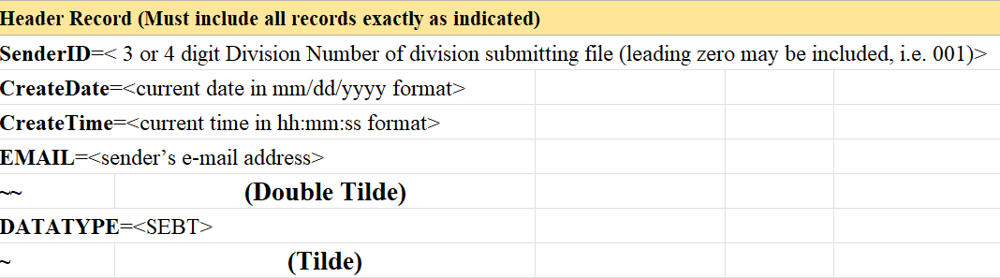
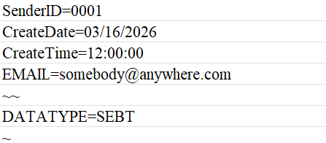
Data File: Header Record
Example
Notes:
The SEBT Eligible Student file consists of four record types: the Header Record, A record, B record, and Trailer Record. First is the header record.
The purpose of this record is to identify the:
Division submitting the file. (3- or 4-digit Division Number; leading zeroes may be included)
Create Date of the file (date in MM/DD/YYYY format)
Create Time of the file (time in HH:MM:SS format)
Email of the sender submitting the file
Data Type of the file (SEBT)
EXAMPLE-this is an example of a correctly formatted Header Record with the required data. The email address submitted in the Header Record will receive all system generated emails from the SEBT application.

Slide 23

DATA FILE:
A RECORD
A for Record Type
File Submission Type Code
Beginning Year of
Current School Year
Division Number
  Three or Four Digit
Notes:
Next is the A record. The A record is different for each submission. For each collection window, the SEBT File A Record will contain:
An A for the record type
The File Submission Type Code.
The beginning year of the current school year: 2025
And your three or four digit division number

Slide 24
A Record - File Submission Type Codes
A252025xxx
Example
Notes:
These codes for file submission type will remain constant for each new school year SEBT collection. The dates of the collection windows will change. It is a coincidence the SEBT file submission type codes include 25 and 26 – they are not related to the school year. They are codes used in the programming to identify the collection window of the records.
EXAMPLE-this is an example of an A record for the first collection (25)in SY2025-2026 (2025) with the xxx representing a public school divisions DIV number.

Slide 25
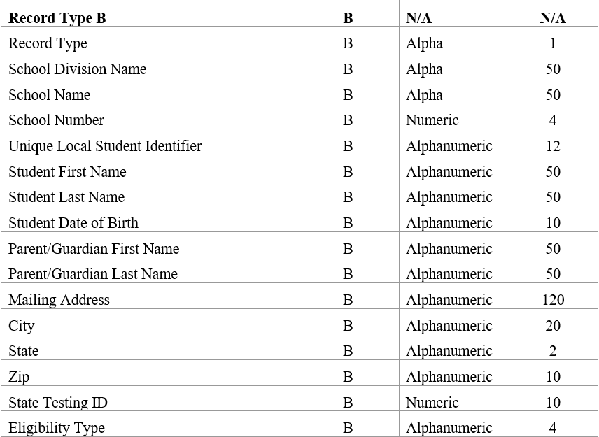
DATA FILE:
B RECORD
Notes:
Next in the file layout is the B record. The B record identifies each student record.
Some of you will have hundreds of eligible student B records and others will have tens of thousands of records – all the student data in the B records must be for F/R eligible students only.
Only students who meet SEBT eligibility requirements should be reported. (attends an NSLP school in person with access to at least one meal and has individual student F/R eligibility.)

Slide 26


SEBT Eligible Student Requirements
Attend in person a school that participates in the National School Lunch Program (NSLP)
Determined free or reduced-price eligible for NSLP by the LEA
  -Data from the School Nutrition Program Administrator
  -CEP school students are NOT all eligible
Student eligibility period for SEBT SY 2025-2026
  -July 1, 2025, through June 30, 2026
Notes:
Question: What two requirements are there for a student to be eligible for SEBT and included in your B records? Type your answer in the chat.
Your eligible students must 1-attend an NSLP school in person with access to at least one meal and 2-be determined F/R eligible to be included in the SEBT file.
The SNP eligibility software report from the SNP administrator is the source for individually determinations for free and reduced-price eligible students.
BONUS: NSLP free and reduced-price eligibility is year long – currently enrolled students with established eligibility at any time during the current school year up to the cutoff date for each collection are SEBT eligible and reported in that file. New eligibility on July 1, 2026, or after applies to SY 2026-2027 and is not included in any SY 2025-2026 collection window.

Slide 27
Record Type-The Record Type is B
Division Name
School Name
School Number
Unique LOCAL Student Identifier
Student First Name
Student Last Name
Student Date of Birth
Parent/Guardian First Name
Parent/Guardian Last Name
Mailing Address
City
State
Zip Code
DATA FILE:
B RECORD
Notes:
The B records provide the data VDOE needs to validate enrollment and eligibility of the student and VDSS needs to deduplicate the record and send the benefits to the responsible adult, by US mail or on an existing EBT card.
Question: Who in the LEA is the keeper of the student data? The data source for the B records is the Student Information System and should align with the most recent Student Record Collection (SRC) submission. SRC and SEBT collections may overlap and VDOE will use the most recent complete submission for validation.

Slide 28
DATA FILE:
B RECORD
State Testing ID*
10-digit State Testing ID assigned to the student
*Private schools must include a blank tab field
Eligibility Type
Eligibility code for category student is individually determined eligible for free or reduced-price meals. Eligibility is required for SEBT benefits.
Notes:
There are two additional elements in the SEBT student information B Record for SY 2025-2026.
State Testing ID and Eligibility Type are used as data integrity and validity metrics for the issuance of monetary federal benefits to households.
The 10-digit State testing ID will also be used to limit each student to be sent to VDSS only once per SEBT program year. Private, non-profit schools (SFAs) participating in the NSLP will not have State testing ID but must include the blank tab field – all records must have the required number of tab fields.
Eligibility type - The eligibility codes are specific to each type of method of eligibility and are used to document the student’s individual eligibility determination. The codes are another assurance the data is valid and the student is eligible for SEBT. Future enhancements may allow the eligibility type code to be used in deduplication of student records compared to the VDSS data sources.

Slide 29
B Record – Eligibility Type
Eligibility Code | Eligibility Determination Type
DCFC | Direct Certification by Foster Care
DCMF | Direct Certification by Medicaid Free
DCMR | Direct Certification by Medicaid Reduced Price
DCO | Direct Certification by Other (used for homeless, migrant, runaway, certain Head Start, and foster care students determined free eligible by documentation other than the VDSS direct certification file)
DCSN | Direct Certification by Supplemental Nutrition Assistance Program (SNAP)
DCTO | Direct Certification by Temporary Assistance for Needy Families (TANF)
FREE | Free by income application
RED | Reduced-Price by income application
Notes:
These are the required eligibility codes. These codes are also requested to be used in the April 1 ISP report backup documentation and should be generated as part of the F/R eligibility report from the SNP eligibility determination software. Appendix B in the Specifications document.

Slide 30
Data File: Trailer Record
The purpose of this record is to provide the count of records for the SEBT File.
FORMAT:
RecordCount=<number of A and B records included in this file (A record plus all B records)>
Notes:
HANDOUT 4 DATA FILE TEMPLATE
The fourth and final record type in the SEBT eligible student data file is the trailer record. The trailer record provides the total record count for the file – the A record plus all B records. The record count in the Trailer record can be found in the Verification Report – about midway through – and is the number that should be compared to the DOE estimated number of SEBT eligible students for the LEA.

Slide 31
Upload Data File
Resolve All issues
Submit For Local Approval
Local SRC Data Approver
Submit For Verification
Goes to Superintendent
Review Verification Report
Local SNP Admin Approver
Collect Data, Follow Specs, Create File
Notes:
The To Do List steps within the SSWS SEBT application are next to finalize and submit your file.
After you upload the data file, resolve all issues, and review the verification report, the submitter will submit the file for local approval, by clicking the link within SSWS.
This will submit the file to the Local SRC Data Approver and the Local SNP Administrator Approver for their verification and approval. This includes validating the number of records in the file compared to previous NSLP eligibility submissions and VDOE estimates.
After local approvals, the Collection Manager will submit the report for Verification, which will send the file to the Superintendent for final verification approval. Please remember only the SEBT Collection manager will have links in SSWS to send the file for final verification and final verification must be completed before the end of the collection window.

Slide 32
SSWS Permissions for SEBT
Upload Data - Allows division staff to upload division SEBT data and upload new versions during an open collection window.
Generate Reports - Allows staff to generate SEBT related reports.
Local SNP Approver - Allows division SNP staff to perform approval of SEBT data.
Local SRC Approver - Allows division SRC staff to perform approval of SEBT data.
Collection Manager - Allows division staff to submit SEBT data for verification by the division. Checks the submitted local approvals status and submits the verification reports for final approval to the Superintendent.
  Assign this role to the staff member responsible for assuring all required approvals are complete and timely before handing it over for the superintendent’s approval.

Slide 33
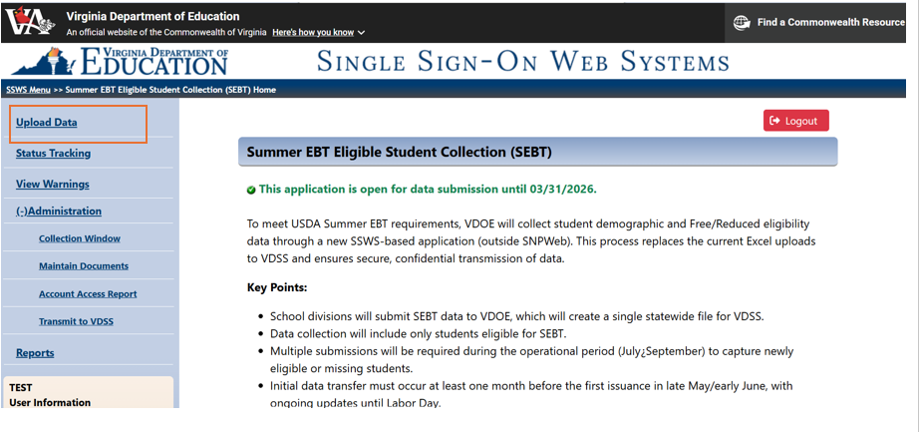
Upload Data Permission - Submitter
Notes:
HANDOUT 5 – ERROR TYPES AND DESCRIPTIONS
All steps in the data file preparation and review process outside of SSWS must be robustly completed and reviewed before the person with upload data permission (we’ll call them the submitter) begins the upload process in the SEBT application by selecting the Upload Data link.
The Submitter is the first person to receive feedback and editing information from the SEBT application on file layout and individual student records. There are two types of errors that must be reviewed and resolved before the file can progress to the next steps.
Warning errors are for questionable data that needs to be verified for accuracy and validity.
Fatal errors stop the record and the from going forward.
The complete list of error types is in Handout 5 and Appendix C of the Specifications document.

Slide 34
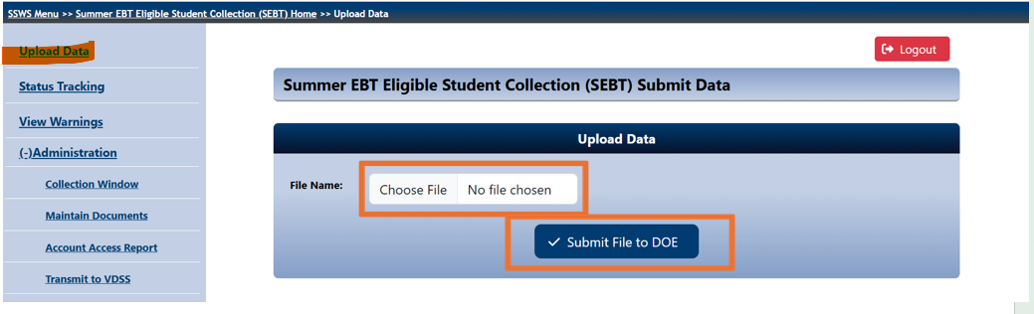
Upload Data Permission - Submitter
Notes:
Click choose file to find the prepared file for the current data collection window (no required file name-suggested elements are in the collection dates chart)
When the correct file is in the File Name field, click Submit File to DOE. This uploads the data in the file to the application to begin the editing and review process.

Slide 35
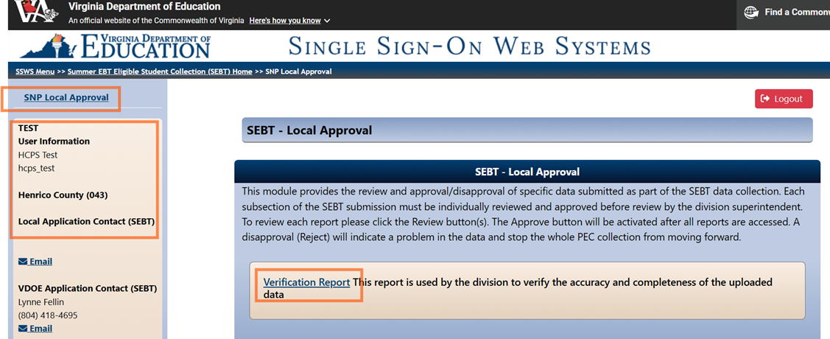

SRC or SNP Local Approver: Step 1
Notes:
There are three main steps for each local approver – SRC and SNP. All steps are critically important to data integrity and validity.
(Static screenshot)
1. Log into the SEBT application, click the Verification Report, and review the data submitted
No errors, number of records compares to DOE estimate, information is complete HANDOUT 6 ELIGIBLE STUDENT ESTIMATES DOE

Slide 36
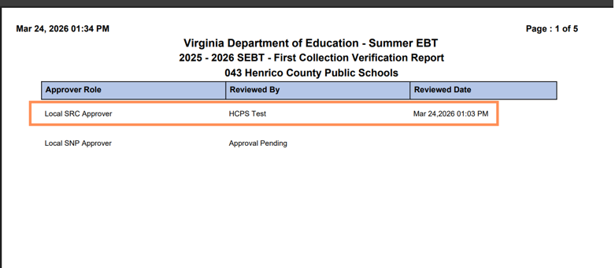
SRC or SNP Local Approver: Step 2
Notes:
2. View verification report status.
(CLICK-Approve/Reject button)
3. Approve or reject.
(CLICK-Status in splash page) Status message on approver splash page.
When each local approver completes review and approves or rejects, a system generated email will go to the Sender’s email address in the file Header Record.

Slide 37
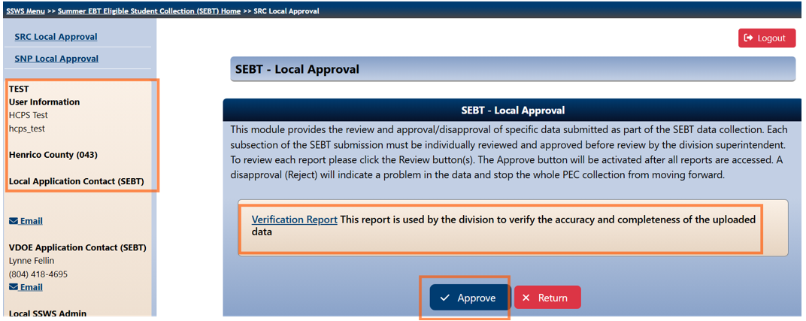
SRC or SNP Local Approver: Step 3
Notes:
3. Approve or reject.
(CLICK-Status in splash page) Status message on approver splash page.
When each local approver completes review and approves or rejects, a system generated email will go to the Sender’s email address in the file Header Record.

Slide 38
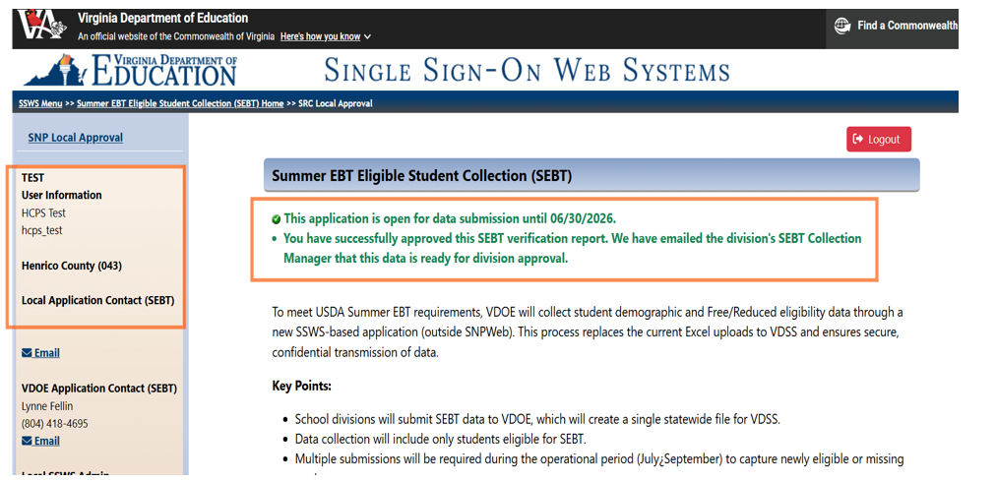
SRC or SNP Local Approver: Status
Notes:
After approval, this status message will appear on the Approver’s main page.
When each local approver completes review and approves or rejects, a system generated email will go to the Sender’s email address in the file Header Record.

Slide 39
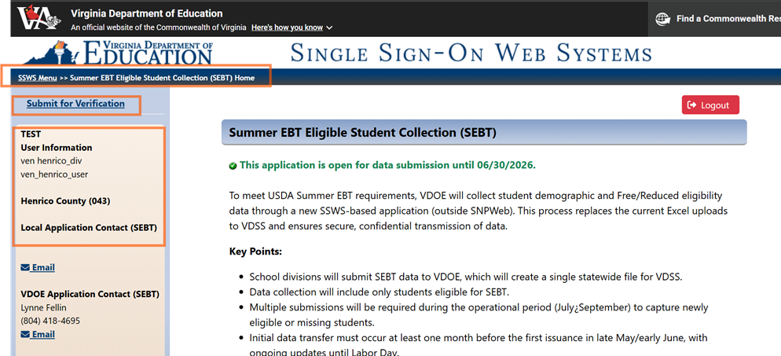
Collection Manager – Step 1
Notes:
The collection manager is truly the gatekeeper for monitoring the LEA’s progress, timely submission, and data integrity. The collection manager is also the person responsible for confirming the file has been thoroughly reviewed and is error free before it moves to the Superintendent for verification and final submission to VDOE.
REMINDER: Submitted data will go forward to DSS to issue the federal SEBT nutrition assistance payments to households

Slide 40
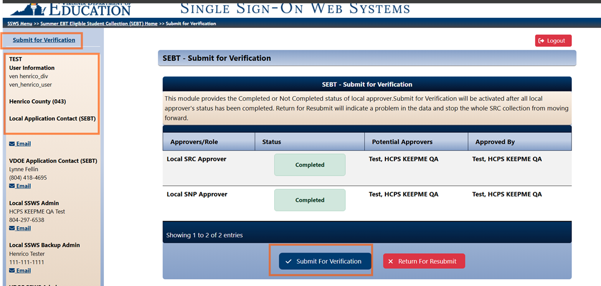
Collection Manager – Approval Status
Notes:
The collection manager is truly the gatekeeper for monitoring the LEA’s progress, timely submission, and data integrity. The collection manager is also the person responsible for confirming the file has been thoroughly reviewed and is error free before it moves to the Superintendent for verification and final submission to VDOE.
REMINDER: Submitted data will go forward to DSS to issue the federal SEBT nutrition assistance payments to households

Slide 41
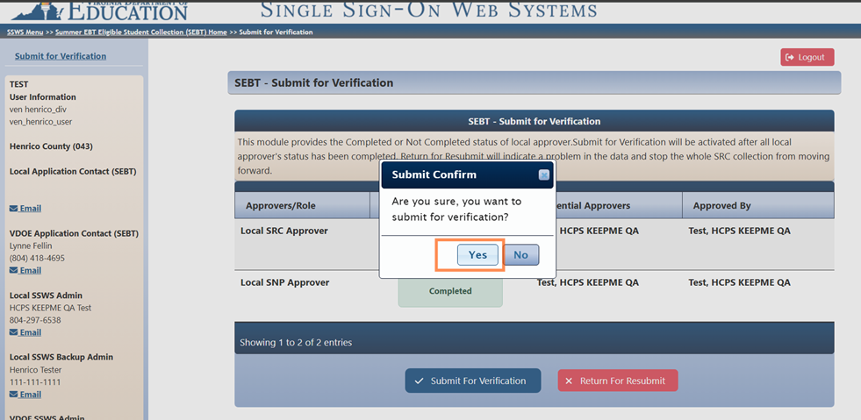
Collection Manager – Last Chance
Notes:
The collection manager is truly the gatekeeper for monitoring the LEA’s progress, timely submission, and data integrity. The collection manager is also the person responsible for confirming the file has been thoroughly reviewed and is error free before it moves to the Superintendent for verification and final submission to VDOE.
REMINDER: Submitted data will go forward to DSS to issue the federal SEBT nutrition assistance payments to households

Slide 42
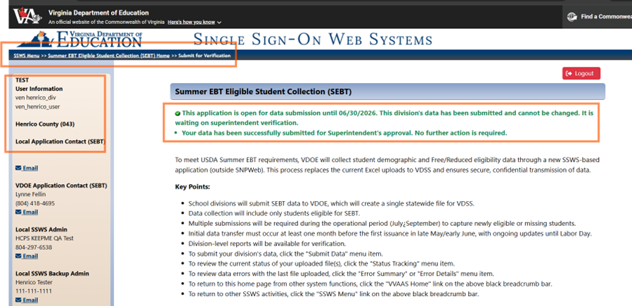
Collection Manager - Status
Notes:
The collection manager is truly the gatekeeper for monitoring the LEA’s progress, timely submission, and data integrity. The collection manager is also the person responsible for confirming the file has been thoroughly reviewed and is error free before it moves to the Superintendent for verification and final submission to VDOE.
REMINDER: Submitted data will go forward to DSS to issue the federal SEBT nutrition assistance payments to households

Slide 43
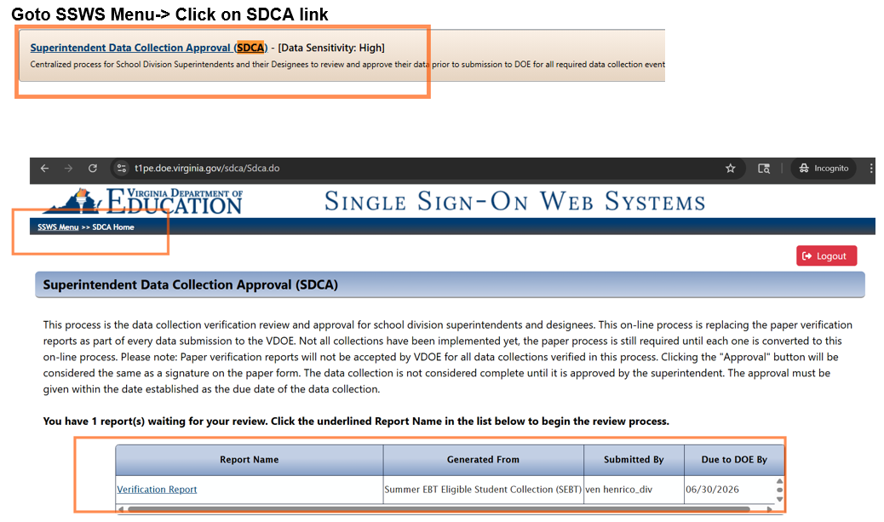
Division Superintendent - SDCA
Notes:
SDCA - Superintendent Data Collection Approval SEBT application must be added by SSWS account manager.
The superintendent is responsible for verification of all LEA data collections submitted to VDOE. They will be relying on the submitter, local approvers, and collection manager to assure all processes and reviews have been completed with accuracy and integrity before they arrive in the SDCA for final verification and approval.

Slide 44
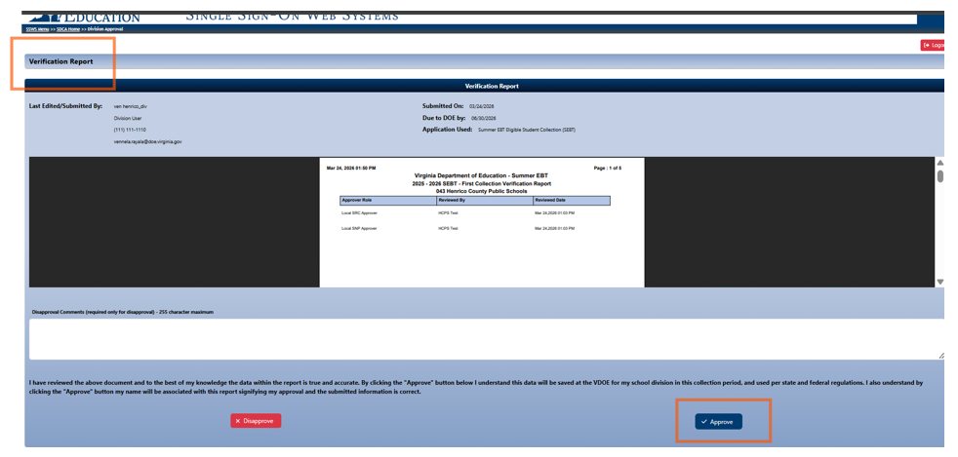

Division Supt. – Aprove/Disapprove
Notes:
The Superintendent may approve or disapprove the verification report for the SEBT collection.
REMINDER: Approval will verify the data can move forward in the submission process and be used for the issuance of federal nutrition assistance.

Slide 45
Resources
Summer EBT Eligible Student (SEBT) Collection webpage – Coming Soon!
Data Collections | Virginia Department of Education
https://www.doe.virginia.gov/data-policy-funding/data-reports/data-collection
Office of School and Community Nutrition Programs/Office of Data Services
Email: resultshelp@doe.virginia.gov
Tuesday Telegram shares important SEBT info for LEA data stewards.
SCNP Dir. Memos and the weekly VDOE Education Update provide info to SNP administrators, LEA partners, and division superintendents
Lynne A. Fellin, SNS, Associate Director, Office of SCNP
Lynne.Fellin@doe.virginia.gov
Notes:
A link to the new SEBT Eligible Student Collection resources will be in the list of Data Collections on the VDOE website at this link as soon as it goes live.
The SEBT webpage will have all the resources listed on Slide 18 of this PP deck that were uploaded to the chat for you today. A pdf of the webinar slides and presenter notes will be added. There will also be a recording of the slide deck contents posted to the VDOE YouTube channel shortly. Data stewards and SNP partners will be notified via the Tuesday Telegram and SCNP Director’s email.
Our VDOE partners in the Office of Data Services will receive your SEBT questions through the ResultsHelp mailbox and direct them to staff to help. SCNP and Data Services are seeking approval to recruit a part-time staff person to support the SEBT collection in partnership with the SCNP and Data Services teams.
If you have questions about the Summer SBT program requirements or student eligibility, please submit them to Results Help until then.

Slide 46

Post Submission
Process
Notes:
After your SEBT file is verified by the superintendent, the post submission process begins.
Earlier we talked about the role of the SSWS account manager or backup manager in assigning permissions for the SEBT application. The account manager also assigns the SEBT application contact in ERA
Getting that right is critical for VDOE to be able to contact the correct person with important SEBT collection updates.

Slide 47
Statewide Data File Process
VDOE consolidates data to single file
VDSS conducts cleansing
VDSS creates state ERR report
VDOE receives ERR report
VDOE fixes if possible
VDOE refers to LEA if resubmission required
VDOE transmits to VDSS
Notes:
What happens to your data after successful submission?
VDOE will consolidate LEA data into a statewide file and transmit it to VDSS for cleansing. VDOE incorporated edits into the SEBT application to align with the VDSS data cleansing process. Your verification report will show fatal errors or warning errors for any data that did not align with SEBT requirements as outlined in the file layout and specifications. Fatal errors had to be corrected before the file could progress.
If VDSS does find errors during the cleansing process that were not identified earlier, those edits and corresponding error messages will be added to the SEBT application for future collection windows.
If VDSS identifies errors that cannot be corrected by VDOE with available data or formatting, the LEA contact for the SEBT application will be notified. If the ERR report must be sent to the LEA, it will be sent via the secure SSWS dropbox to the LEA contact identified by the SSWS account manager in the ERA – make sure it is the correct person who can receive critical information about the SEBT collection and take timely action, as needed.

Slide 48
First Collection Window SEBT Eligible Student File Errors
April 15 – April 28
{
April 15
April 28
VDSS Production Period Closes
May 1
Most recent file overwrites previous file in SSWS SEBT application.
Resubmit all eligible records for that data collection every time.
VDOE will reopen LEA collection window for resubmission if within window and DSS cutoff date.
If VDSS period is closed, LEA will correct errored records and submit in data file for next collection.
Resubmitted file(s) must include
all records, not just fixed records
Notes:
During the FIRST collection window, April 15-28, every file LEAs submit will be consolidated with all other LEA records and transmitted to VDSS.
VDSS will conduct data cleansing and return a consolidated ERR report to VDOE. Any errors that cannot be corrected by VDOE will be referred to the LEA.
If the date for VDSS acceptance of VDOE data has not passed, VDOE will re-open the LEA’s collection window. The LEA will edit the errored data and make a resubmission. The VDOE post submission cycle will restart.
If the date for VDSS acceptance of VDOE data has passed, individual student errored records will be corrected by the LEA and included in the LEA file for the next collection window. Those errored records will not receive benefits on the issuance date for the First collection.

Slide 49
Communications
Notes:
What’s the plan- how do I get started?
Here are some ideas for what you can do now to be ready for SEBT file creation and SEBT success.

Slide 50






Plan for Summer EBT Success
Engage
LEA and school staff and community partners in supporting Summer EBT
Communicate
frequently with LEA and school staff, parents and guardians, and the community
Energize
households, school staff, and the community about the SUN Meals programs along with SUN Bucks to share how children can also receive no cost meals and snacks in the summer.
Use a variety of communication channels to reach all audiences for awareness and increased understanding
Notes:
Engage your partners at school and in the community to support SUN Bucks. Frequent communication about SUN Bucks with LEA and school staff, parents, guardians and community partners will help awareness and readiness for SEBT data collection and all that happens after.
SUN Meals and SUN Bucks work hand in hand to provide nutritious meals and food to children during the summer, a time food insecurity usually increases. Creating energy and excitement for all SUN programs can help to reduce hunger and improve student outcomes.

Slide 51

Summer EBT Notification Ideas
Notify households if students are automatically eligible for SUN Bucks
Request households update mailing address and parent/guardian name in SIS to prepare for Summer EBT data
Notify partners and supporters of how students will be eligible for Summer EBT and how to help students and families who must apply
Distribute paper SEBT applications in CEP schools
Information blitz on where to find and record local student ID number for SEBT application.
LEA Media Release
Toolkit Tip: Household notification and media release templates for CEP
51
Notes:
LEAs have shared these ideas for what they did to improve data quality, increase awareness, and reduce phone calls to schools and other contacts about SUN Bucks concerns.

Slide 52

Summer EBT Benefits and Information
One issuance of $120 lump sum to EBT card
  Existing EBT cards for SNAP.
  New VA SUN Bucks cards mailed to households receiving SUN Bucks only
  Issuance dates for each data file in collection window table.
Questions to VDSS
  VA SUN Bucks website
  FAQs and SEBT Applications (5/1)
VA SUN Bucks call center (6/15)
  Household questions about benefits
Replacement SEBT card instructions from ConnectEBT, VDSS call center, or local DSS office (LDSS)
Notes:
This slide is a summary of FAQs about SUN Bucks and benefit related concerns – how much, where the benefit will be issued, and when.
All household and community questions should be directed to VDSS – SUN Bucks website is now live year-round with FAQs and a link for households to submit questions. The downloadable SEBT application form is available on the website and a new, online SEBT application may be available to households in May, stay tuned.
The call center will open in mid-June to take SEBT applications by phone and answer household questions. The local DSS offices (LDSS) will also receive broadcast messages from VDSS about Virginia SUN Bucks and should be prepared to answer household questions.
Schools and school divisions do not have the information or the responsibility to answer questions about SUN Bucks benefits for eligible households.

Slide 53
LEA Only VDSS SEBT Issuance Questions
VDSS has activated a Summer EBT email address for LEA only questions about benefits.
Email address for use by LEA staff only. Please do not share with households. LEA questions about an eligible household’s receipt of benefits, including mailing address updates and changes to parent/guardian.
Copy Lynne Fellin on emails as needed.
VDSS SEBT LEA Inquiry post issuance questions ONLY:
sebtleainquiry@dss.virginia.gov
Notes:
How can LEAs get information to VDSS about specific household issues after benefits are issued - The SEBT LEA inquiry mailbox for LEAs only will be active beginning in May/June for the period after benefits are first issued to households in June through the end of the SY 2025-2026 operational period.
Only LEA staff with responsibility for answering questions from households or providing information like address or parent/guardian name correction should use this email address. If a household contacts you, had a change of address and didn’t receive their SUN Bucks card, this is the email for the school division SNP administrator to use to notify VDSS so they can make a correction. Changes to a parent/guardian submitted for a specific child can also be reported to VDSS va this mailbox.
Questions about the SEBT Eligible Student Data Collection process and file should NOT be sent to this VDSS email account.
Contact VDOE at ResultsHelp@doe.virginia.gov for file creation, submission, and file error questions.

Slide 54

Tools for Summer EBT
VDSS Communications Plan
  Virginia SUN Bucks website – VirginiaSunBucks.com
  Virginia SUN Bucks call center 6/15
  Media release and information release to partners/stakeholders
  Broadcast message to local DSS (LDSS) offices with supporting materials
  Social media posts with public targeted messages
Communication Tools for LEAs VirginiaSunBucks.com
  Virginia SUN Bucks Basic FAQs
  Virginia SUN Bucks Flyer
Notes:
This list of tools for SEBT communication is another resource for LEAs in successful promotion of SUN Bucks

Slide 55

Ready, Set, Go!
Notes:
.

Slide 56
Summer EBT Action Items
Review webinar information and SEBT Supporting Documents from VDOE.
Complete Summer EBT addendum from SNPWeb Download Forms and upload Superintendent signed copy to Application Packet Supporting Documents
Work with LEA SSWS account manager on role-based permissions for SEBT Eligible Student application, when it goes live.
Develop and implement process for data file extract from SIS and file layout.
Create and submit SEBT Eligible Student File. Conduct review and approval process. Submit to Superintendent for verification.
Communicate with households and stakeholders about all SUN programs
Notes:
Action Items:
Review resources.
Submit SEBT addendum. – SNP administrator download the SY2025-2026 addendum to the Agreement from SNPWeb>Download Forms>Addendums. Route to Superintendent for signature. Upload igned SBET addendum SY2025-2026 Application Packet, Attachments List.
Get your SSWS permissions
Lock in dates on your calendar for file development, editing, and data validation.
Submit first Summer EBT SY 2025-2026 data file when the window opens April 15.
Final, error free records must be submitted to VDOE by COB April 28 for review and transmission to VDSS May 1. Benefit issuance will begin June 22. .
Put up your feet, get a drink of water, and congratulate yourselves for a job well done.

Slide 57
Questions?
If you have questions, please type them in the Q&A box.
Notes:
Please type any remaining questions in the Q&A box…

Slide 58





VDOE School and Community Nutrition
Connect With Us!!
@vdoescnp
@vdoescnp
Scan the QR code to visit our website!

Slide 59
COMMONLY USED ACRONYMS
ASP: Afterschool Snack Program
BAB: Breakfast After the Bell
CACFP: Child and Adult Care Food Program
CEP: Community Eligibility Program
CFR: Code of Federal Regulations
DC: Direct Certification
DOD: Department of Defense
DOE: Department of Education
FFVP: Fresh Fruit and Vegetable Program
FNIC: Food and Nutrition Information Center
FNS: Food and Nutrition Service
FSMC: Food Service Management Company
GBD: Grain-based Desserts
ICN: Institute of Child Nutrition
IS: Identified Student
ISP: Identified Student Percentage
LEA: Local Education Agency
MARO: Mid Atlantic Regional Office (USDA-FNS)
NSLP: National School Lunch Program
POS: Point of Sale
RCCI: Residential Child Care Institution
SBP: School Breakfast Program
SCA: Supply Chain Assistance
SEBT: Summer Electronic Benefits Transfer
SFA: School Food Authority
SFSP: Summer Food Service Program
SMP: Special Milk Program
SNP: School Nutrition Programs
SRC: Student Record Collection
SSO: Seamless Summer Option
SSWS: Single Sign-on for Web Systems
USDA: U. S. Department of Agriculture
VDACS: Virginia Department of Agriculture and Consumer Services
VDOE: Virginia Department of Education
VDH: Virginia Department of Health
VDSS: Virginia Department of Social Services

