Slide 1
Mathematics Advisory Task Force
November 19, 2025

Slide 2
Welcome Mathematics Advisory Task Force Members
Name | Stakeholder Group
Kristen Amundson | Former Executive Director of NASBE; Former member Virginia House of Delegates; Former Member of Fairfax County School Board
John Beres | Division Mathematics Supervisor
Douglas Brown | School Board Member
Vitesh Chawda | Workforce: Senior Project Engineer
Carin DeClute | Instructional Coach: Elementary Mathematics Specialist
Liz Lynch | Elementary STEM Teacher
Sarah Medukas | Elementary Assistant Principal
Charles Motter | Middle School Mathematics Teacher
Padmanabhan Seshaiyer, Ph.D. | Higher Education
Tamara Smith-Moyler, Ed.D. | Higher Education
Todd Truitt | Parent
Rhonda White | Division Mathematics Supervisor
Avanti Yamamoto | High School Mathematics Teacher

Slide 3
Meeting Purpose and Agenda
Purpose: To review recent statewide and national mathematics actions and begin sharing recommendations that will inform statewide priorities and the Virginia Consolidated State Plan.
Topic | Time
Welcome, Purpose, and Introductions | 5 mins
Review of Recently Released Math Reports | 10 mins
Discuss National Research Findings | 15 mins
Begin Crafting Recommendations | 25 mins
Next Steps | 5 mins
Guest Speaker
Alissa Peltzman, Independent Consultant
Co-author of Charting the Course: The State of Mathematics Pathways for Student Success: Research of nine key policies and practices to effectively implement high-quality mathematics pathways
Notes:
Tiara

Slide 4
HB1600 Defines Required Department of Education Actions for Mathematics
(i) oversee and track mathematics instruction, assessment scores, and learning outcomes in the Commonwealth to identify potential areas for improvement;
(ii) identify evidence-based and proven best practices to improve mathematics instruction and student performance;
(iii) establish the framework for and support the implementation of professional development strategies for educators and school systems;
(iv) administer state funds provided to school divisions as appropriate;
(v) collaborate with school boards and division superintendents to support the implementation of competency-based and evidence-based mathematics learning, provide recommendations on best practices, and facilitate professional development opportunities for educators;
(vi) oversee the statewide professional development framework for evidence-based teacher training, provide instructional guides and evidence-based resources, and facilitate regional professional development networks on improving mathematics; and
(vii) collect data to analyze student mathematics progress and report the impact on student success across the Commonwealth.
HB1600

Slide 5
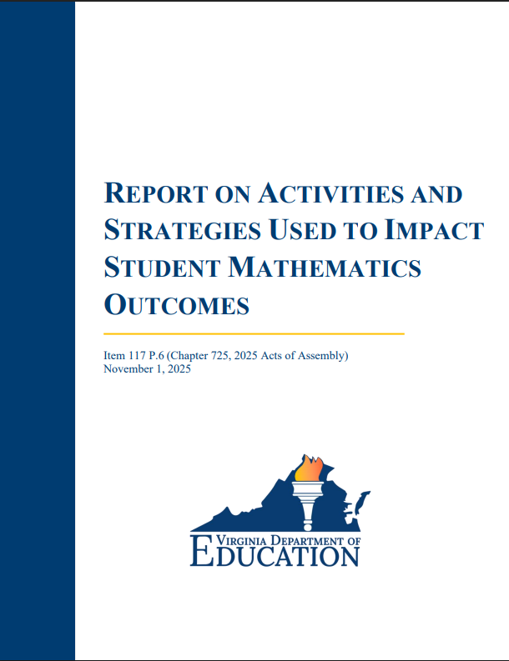
Annual Mathematics Report Shares Actions Taken to Improve Mathematics Across the Commonwealth
Key items to highlight from the report
Progress on meeting defined state requirements.
Implementation updates on the Mathematics Standards of Learning.
Status of grant funding.
Expansion of virtual mathematics course opportunities to support acceleration in mathematics.
Innovative avenues to expand teacher endorsements in mathematics.
Recommendations to strengthen instruction and support.
https://rga.lis.virginia.gov/Published/2025/RD741/PDF
Notes:
Status of Grant funding: Current status- Acceleration Phase I complete and targeted students’ enrollment in virtual courses. Acceleration Phase II (virtual coursework and expanded teacher endorsements) and the Innovative application window are closed and staff are currently using rubrics to review submissions. MSTC grant application process in progress.
Innovative avenues to expand teacher endorsements: This could be the legislated methods to expand endorsements (praxis, praxis bridge, coursework etc.) or the stipend for teaching in high needs schools (Middle School Teacher Corp).
Recommendations for future improvement from GA report include
Professional development- sustained, research based, targeted PD to support varied education stakeholders.
Promote advanced coursework in mathematics
Targeted regional support- provide comprehensive targeted support to divisions, particularly those identified as high need
Support for the adoption and implementation of HQIM
Promote innovative practices to support the development of competency-based learning
Collaborate with Educator Preparation Programs to share best practices, resources, and initiatives that will inform EPP programs and support developing teachers. The Department to work with school divisions to develop or inform mentorship programs that support new teachers in mathematics.

Slide 6
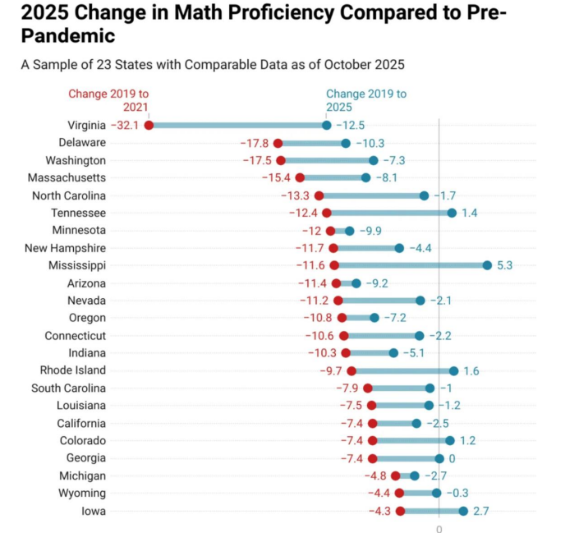
Virginia Students are Making Meaningful Progress
Notes:
2025 Change in Math Proficiency Compared to Pre-Pandemic Sample by Education Data Center
This demonstrates that Virginia’s math proficiency rate among students in grades 3-8 dropped 32.1 percentage points between spring 2019 and 2021 [red dot]. Between 2019 and 2025, the proficiency rate dropped 12.5 percentage point [blue dot]. While Virginia had one of the largest overall losses since 2019, pace of recovery from 2021 to 2025 is among the fastest in the country at +19.6 points regained. This is a roughly 61% rebound from the pandemic-era low and Virginia is recovering faster than nearly every other state shown. While there is more to do, Virginia students are making meaningful progress.

Slide 7
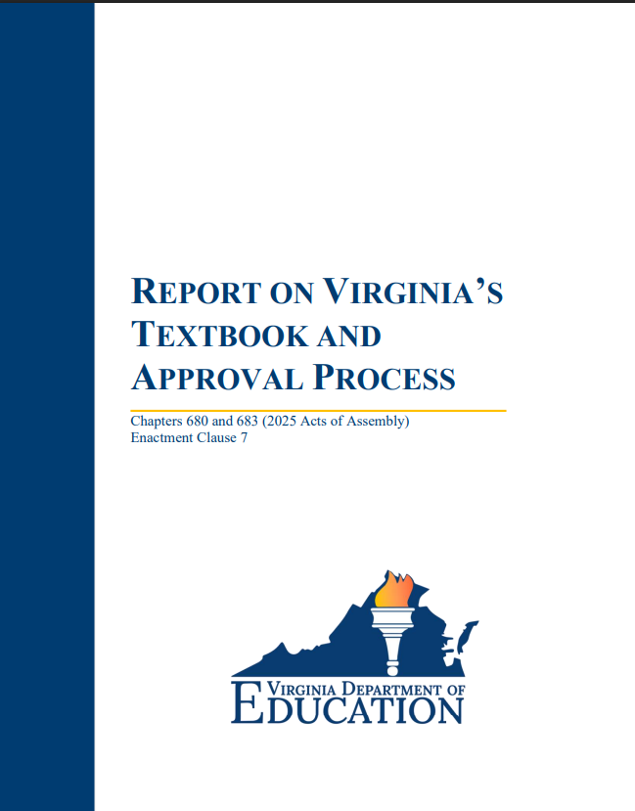
Updating Virginia's Textbook and High-Quality Instructional Materials (HQIM) Process
Stakeholder feedback highlights the following priorities with HQIM
Trustworthiness
Demonstrated record of success
Inclusion of Instructional practices aligned with research and evidence-based best practices
Guidance for meeting student needs (advanced learners, English Learners, students with disabilities).
Resources for teachers to develop content knowledge
Best practices for the selection of HQIM
Best practices for the local implementation of HQIM
Department support structures
Sample rubric will be provided with the caveat that it will be adapted to support discipline specific best practices.
https://rga.lis.virginia.gov/Published/2025/RD715/PDF
Notes:
Best practices for the selection of HQIM
Engage committees in a rigorous local HQIM vetting process.
Review HQIM and determine gaps with accessibility.
Conduct practical and technical review.
Best practices for the local implementation of HQIM
Develop and implement a strategic plan for HQIM rollout.
Provide targeted and sustained professional learning.
Support structures for HQIM selection and implementation include
Review Committee Correlation Reports (focus on alignment to standards)
Coming Soon: Correlation at a Glance documents per publisher
Mathematics Playbook: Instructional Structures and Support
Virginia Mathematics Textbook and Instructional Materials Implementation Tool
Mathematics Instructional Guides
Concepts and Connections Articulation Guide

Slide 8
Mathematics Advisory Task Force Will Provide Recommendations to Improve Mathematics Across the Commonwealth
The Department shall establish and oversee a Mathematics Advisory Task Force to provide recommendations on improving mathematics education in elementary, middle, and high school.

Slide 9
Beginning with the End in Mind
Develop a comprehensive report with actionable recommendations for improving mathematics.
Identify resources, support, and conditions needed to actualize the recommendations.
Define measures of effectiveness to evaluate the impact of implemented recommendations.
Recommendations will be informed by research, promising practices, and innovative approaches tailored to Virginia's context.

Slide 10
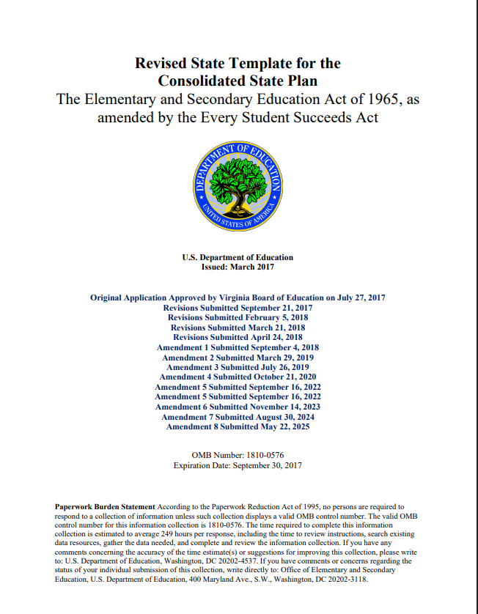
Opportunity to Inform Virginia's Consolidated State Plan Revisions
As the task force considers key actions and recommendations to chart the course of mathematics, identify if recommendations should be incorporated into Virginia's Consolidated State Plan.
https://www.doe.virginia.gov/home/showpublisheddocument/52591/638884565887170000

Slide 11
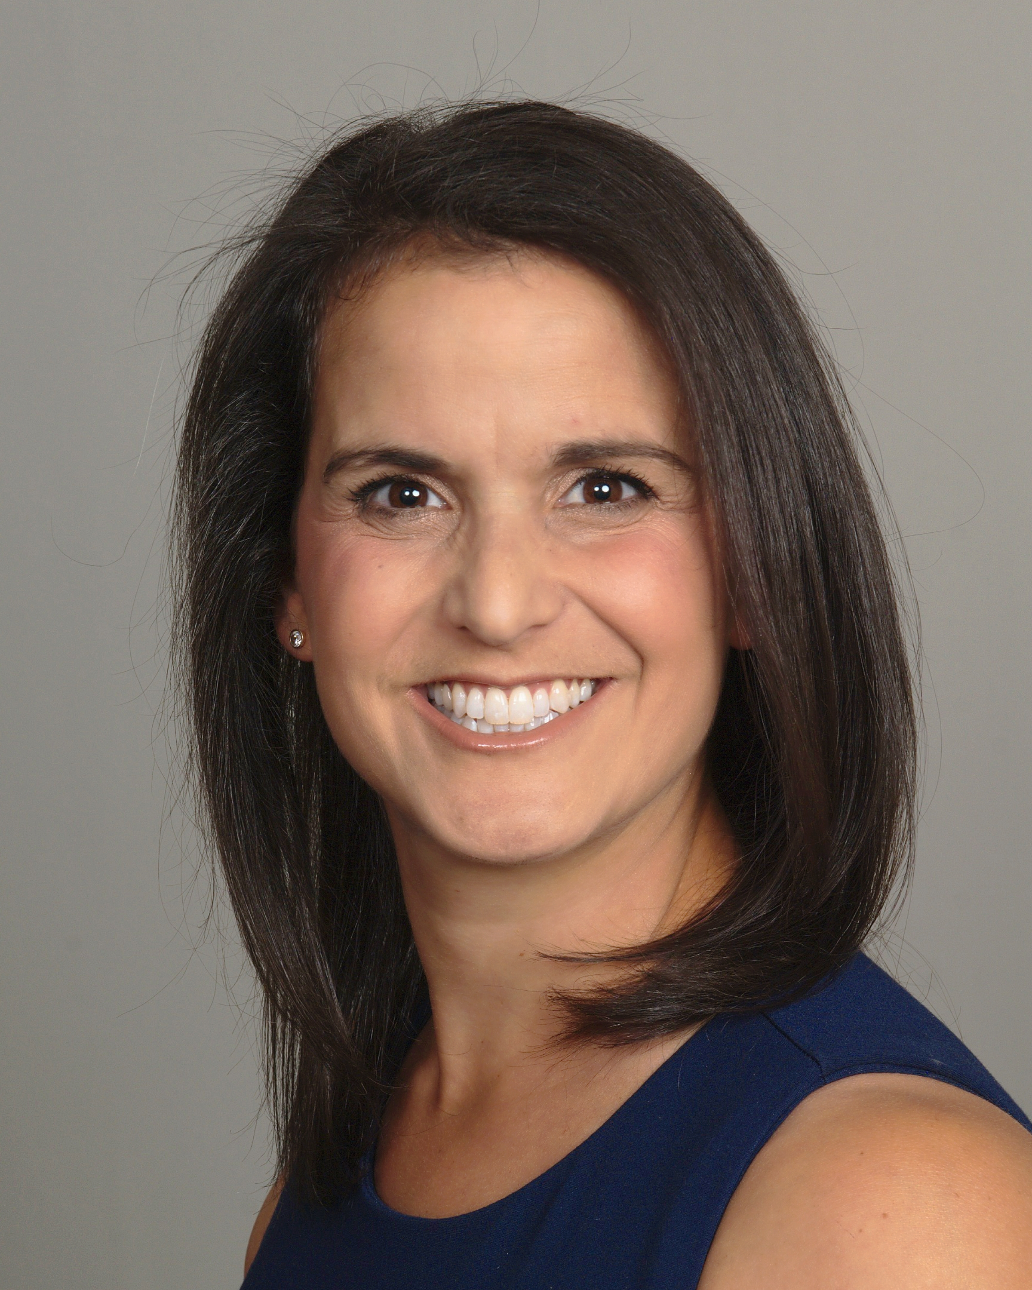
Charting the Course: The State of Mathematics Pathways for Student Success
Alissa Peltzman, Independent Consultant
Chief Council of State School Officers (CCSSO) Instructional Materials Professional Development (IMPD) Network Coach
Education Strategy Group (ESG)

Slide 12
Charting the Course for Mathematics in Virginia
Which key takeaways from the presentation are most relevant to inform state-level recommendations?
How can these insights be applied to strengthen the direction of mathematics and guide updates in Virginia's Consolidated State Plan?
What feedback does this task force have on submitted mathematics recommendations and should it be included as an update in Virginia's Consolidated State Plan?

Slide 13
Submitted Math Recommendation for Consideration by the Task Force
"Ready Students" in the Virginia Consolidated State Plan are students with the potential to succeed in advanced high school mathematics in grade 8 as measured by performance on mathematics Standards of Learning (SOL) assessments.
The "Ready Student" count is used for various accountability calculations.
"Ready Students" include any student enrolled in grades 6-8 who takes a high school end of course assessment (Algebra I, Algebra II, etc.) and any grade 8 student not enrolled in a high school math course but who scored advanced on the Grade 7 Mathematics SOL Assessment in the previous school year.
Question for discussion: Should the "Ready Student" count be expanded to include any grade 8 student not enrolled in a high school math course who scored proficient on the Grade 7 Mathematics SOL assessment?

Slide 14
Breakout Room Discussion Questions
Which key takeaways from the presentation are most relevant to inform state-level recommendations?
How can insights from the Charting the Course presentation be applied to strengthen the direction of mathematics and guide updates in Virginia's Consolidated State Plan?
Should the "Ready Student" count be expanded to include any grade 8 student not enrolled in a high school math course who scored proficient on the grade 7 mathematics SOL assessment?

Slide 15
Breakout Room Discussions

Slide 16
Recommendations to Improve Mathematics
In breakout rooms, individually reflect on what you see as key priorities or takeaways from the overall presentation.
Think broadly:
Overall takeaways that can be applied to strengthen mathematics in Virginia
Insights from the Charting the Course presentation to consider as an update to the Virginia Consolidated State Plan
Suggestions for “Ready Student” count
The facilitator will capture notes in the virtual whiteboard.

Slide 17
Recommendations to Improve Mathematics
Spokesperson for your group please share:
Overall takeaways from your group that can be applied to strengthen mathematics in Virginia
Group insights from the Charting the Course presentation to consider as an update to the Virginia Consolidated State Plan
Suggestions for “Ready Student” count

Slide 18
Reflection and Next Steps

Slide 19
Recommendations Next Steps
The Department will use insights from this meeting to review your responses today and your feedback on the Virginia Consolidated State Plan to inform recommendations on the proposed Plan.
Draft recommendations will be sent to the Task Force members for feedback in mid-December.

Slide 20
Prior to Next Meeting
Provide Comments by December 10, 2025.
Read the following reports
https://rga.lis.virginia.gov/Published/2025/RD715/PDF
https://rga.lis.virginia.gov/Published/2025/RD741/PDF

Slide 21
Next Steps
Mathematics team will send documents for your review with feedback form for recommendations on Virginia Consolidated Plan.
Recommendations due to Department by December 10, 2025.
Department will synthesize your feedback to inform draft recommendations on the Virginia Consolidated Plan by December 19, 2025.

Slide 22

Next Meeting: January 7, 2026 4:00 p.m. - 5:00 p.m.

