Slide 1
Master Schedule Data Collection
2022-2023 EOY
2023-2024 SY

Slide 2
A
AGENDA
Updates
Reports
  MSC Verification Report
  Contracted MOPs for Divisions Report
Timeline and Resources
Questions

Slide 3
EOY 2022-2023 Edit
Data Element
  Work-based Learning
Edit
  A student must be 15 years or older on Oct 1st if reporting codes 1, 2 and 9 in the F Record.
  1 = Cooperative Education
  2 = Registered Apprenticeship
  9 = Youth Registered Apprenticeship

Slide 4
EOY 2022-2023 Update
Divisions will no longer report MSC data for students served in a VDOE licensed Private School for Students with Disabilities.
Edit
  Serving division can not be 600 when the reporting division is an LEA or a regional center
Notes
  VDOE non-licensed private schools and out of state placed students should continue to be reported by the division
    New Community (0701)
    St. Mary’s (1241)
    The Auburn School (1251)
  IPAL and SEDF reports will not be affected
  Continue to report SRC and SBAR data for all funded students

Slide 5
2023-2024 New Data Element
Data Element
  At Least 50% Enrollment Flag - A flag to indicate a student was enrolled in a course, regardless of the section, at least 50% of the term reported.
Values
  Y= Yes, student was enrolled in the course at least 50% of the term reported
  N=No, student was not enrolled in the course at least 50% of the term reported
Edits
  Only collected on EOY MSC
  Only Division 501 (Virtual Virginia) is required to report on EOY 2022-2023
  All divisions and regional centers are required to report on EOY 2023-2024

Slide 6
2023-2024 Update
Data Element
  Responsible Division
Edit
  Blanks will not be permitted
  Must be a valid VDOE assigned division number (<=207)
Notes
  In previous years, only regional centers were required to report a responsible division. This is being expanded to include all divisions and regional centers.

Slide 7
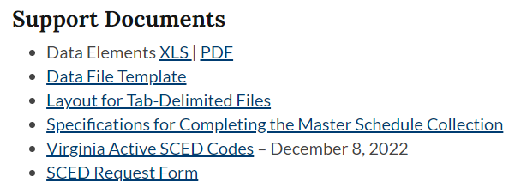

Va Active SCED List
Update
  Added Transcript/Secondary Course column
  Removed the Order column
  Added a change log for the current and past school year
  Column heading updated from Virginia Assignment Title to Course Title
SCED Request Form
  A New Request Form is located on the MSC website

Slide 8
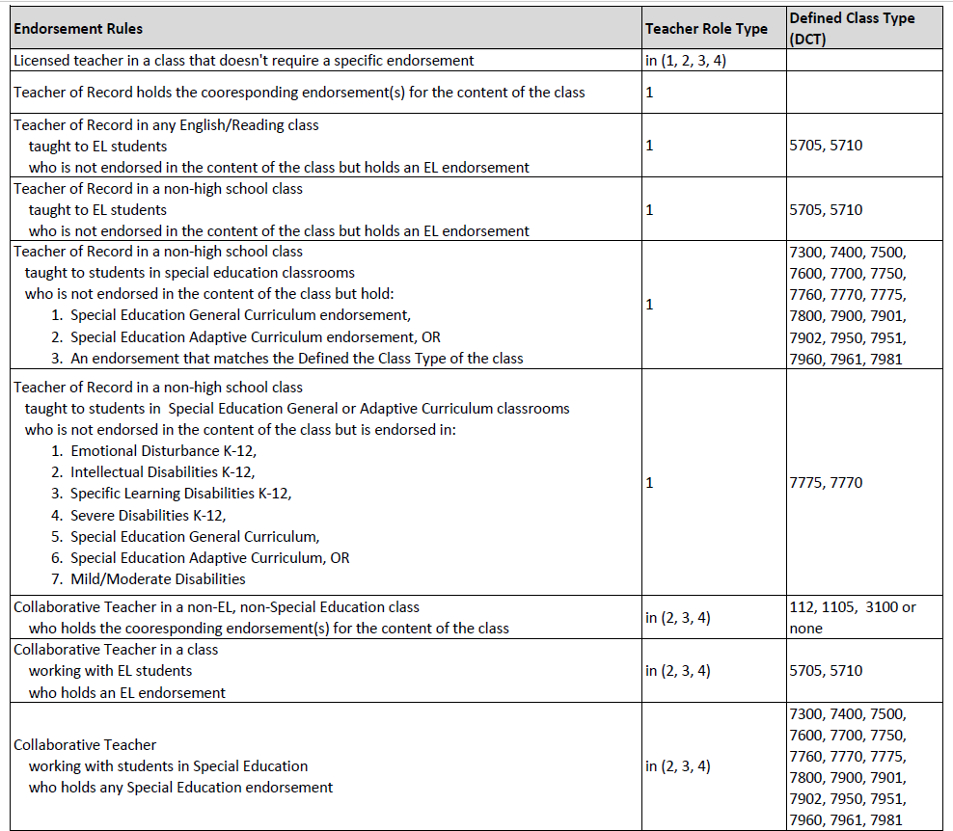
IPAL Rules
Notes:
Secondary or transcript like courses require the lead teacher to hold an endorsement in the content.
A special ed teacher in a self contained special ed class must hold an endorsement in the content, not the DCT reported.
The DCT is only considered if they are reported as an additional teacher.
Line 7 - Reading Specialist, Gifted or Math Specialist must be endorsed in the content even if a DCT is reported.

Slide 9
Reporting G Records
Fatal Error for Teacher Role Code
  There must be at least one record with a role code of “8” included in the G Record
Warnings for VA Assignment Code
  There must be at least one G record for an
    elementary guidance counselor (0103)
    secondary guidance counselor (0104, 0105 or 0106)
    librarian (0025 or 0131)
Note
  Code 7: Pupil Personnel Service Provider includes School Counselors, School Psychologist, School Social Worker, and Vocational Evaluators
  Code 8: Administrator includes Principals and Assistant Principals
  Code 10: Other Staff Not connected to a section
Code | Description
7 | Pupil Personnel Service Provider
8 | Administrator
10 | Other Staff Not Connected to a Section
Notes:
Code 10 is used for any staff that has contact with students but not assigned to a section.
If the First Year Administrator Flag is Y and the Code = 8, then Division Administrative Experience and Total Years of Administrative Experience must be zero.

Slide 10
MSC Reports

Slide 11
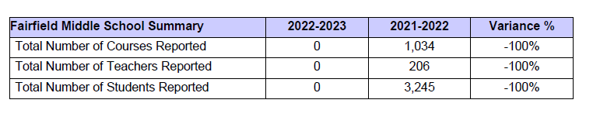
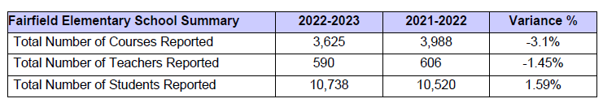
MSC Verification Report
This report provides the division verification data for MSC
Added school level tables
  Total Number of Courses Reported
  Total Number of Teachers Reported
  Total Number of Students Reported

Slide 12
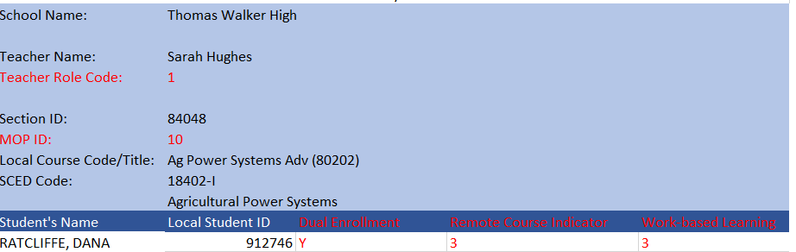
MSC Detail Report PDF and XLS
Teacher Role Code MOP ID
Dual Enrollment Remote Course Indicator
Work-base Learning

Slide 13
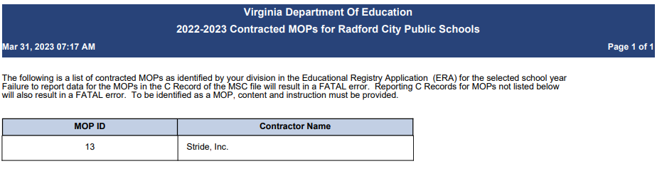
Contracted MOPs for School Divisions
The following is a list of contracted MOPs as identified by your division in the Educational Registry Application (ERA) for this school year. Failure to report data for the selected MOPs will result in a FATAL error. Reporting MOPs not selected will also result in a FATAL error.
To be identified as a MOP, content and instruction must be provided.
Notes:
ERA and MSC must match
If it's not selected in ERA then it can't be reported on the MSC
If it's selected in ERA then it can't be reported on MSC

Slide 14
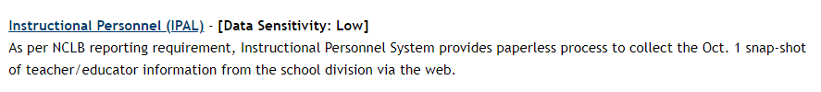
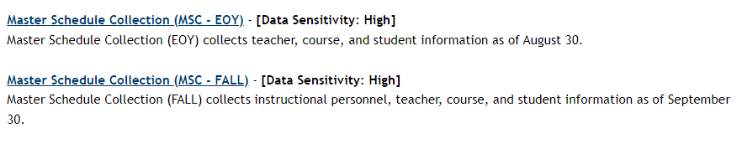
IPAL and SEDF Verification Report
Applications
The IPAL and SEDF applications are separate from the MSC application. Verification reports are located under the application it pertains to.
The SEDF approval link will not be active until an explanation is submitted.
Notes:
Click Send Explanations twice, once to save the list the second time will send the explanations to VDOE for approval.

Slide 15
timeline and Resources

Slide 16
MSC Data Reporting Timeline
File Submission | Opening Date | Closing Date | Snapshot Date
End of Year 22-23 | May 10, 2023 | August 14, 2023 | First day of school through the end of 22-23 summer school
Fall 23-24 | October 2023 | January 2024 | Teacher and student status on October 1st
End of Year 23-24 | May 2024 | August 2024 | First day of school through the end of 23-24 summer school
Notes:
Courses taken during summer school for high school credit or needed for promotion only.
Fall 23-24
Opening October 2023
Closing January 2024
Teacher and student status on Oct 1st. Report the teacher and students schedule assigned so far on Oct 1st.

Slide 17
MSC Application Support
Contact your local SSWS Account or back-up Account Manager if you need assistance with the following:
Assigning the MSC application contact in ERA
  This is critical for VDOE to contact the correct person with important updates
Determining rights and privileges to the MSC application
  This includes setting up the MSC collection managers, local approvers, and rights to submit the data or access reports
Establishing Superintendent Data Collection Approval (SDCA) account for Superintendent or Director

Slide 18
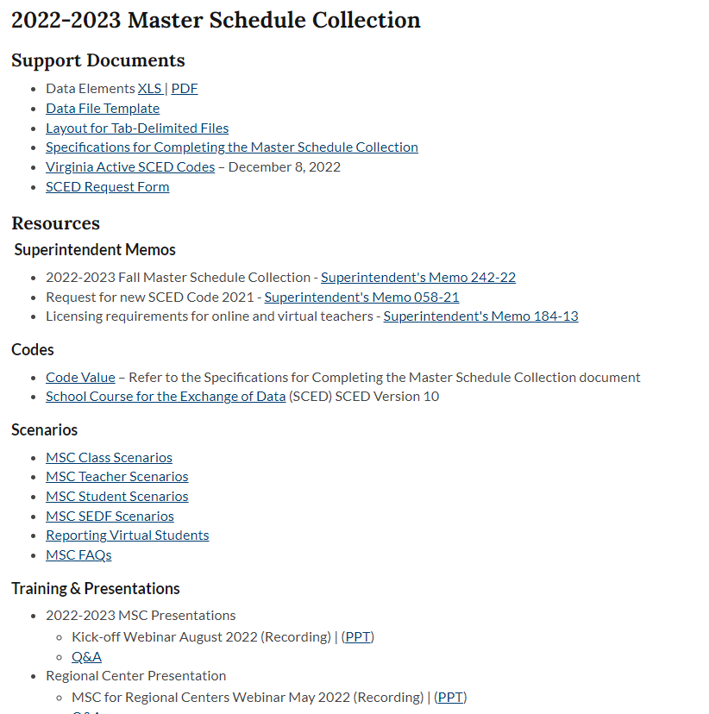
MSC Website
Data, Policy & Funding/Data & Reports/Data Collection/Master Schedule Collection

Slide 19
VDOE Contacts
Dana Ratcliffe, Educational Data Specialist, Office of Data Services
Email: Dana.Ratcliffe@doe.virginia.gov or
ResultsHelp@doe.virginia.gov 7:30 am to 4:00 pm, Monday through Friday except for state holidays
Carol Wells Bazzichi, Associate Directory, Office of Data Services
Email: Carol.WellsBazzichi@doe.virginia.gov
Joseph Ryder, Office of Career, Technical, and Adult Education
Email: JosephRyder@doe.virginia.gov
Maggie Clemmons, Office of Licensure and School Leadership
Email: MaggieClemmons@doe.virginia.gov

