Slide 1
Student Behavior and Administrative Response Collection
August 21, 2020

Slide 2
Agenda
Model Guidance for Positive and Preventative Code of Student Conduct
Introduce the four record types in SBAR
Data elements within each record type
The valid values for each data element
Tentative timeline
Questions

Slide 3

Webinar Participation
Please type your questions in the Q&A box found at the bottom of your screen.
This presentation will be available on the Student Behavior and Administrative Response webpage

Slide 4


Goals of Model Guidance
Address the BOE’s goal to provide guidance for creating safe, supportive, effective learning environments.
Address the data inequities in outcomes for students of color and students with disabilities.
Reduce exclusionary approaches to discipline.
4

Slide 5

Social Emotional Learning Skills
Self Awareness
Self Management
Social Awareness
Relationship Skills
Decision-making Skills
Profile of a Virginia Graduate
Notes:
Explicit instruction in social emotional learning is an approach to ensuring students achieve the profile of a graduate. Teaching Self Awareness, Self Management, Social Awareness, Relationship Skills, and Decision-making skills is a precursor student’s acquisition of the 5 C’s in the Profile of a Virginia Graduate. In 2020, The Virginia General Assembly directed the Department of Education to establish a uniform definition of social-emotional learning and develop guidance standards for social-emotional learning for all public students in kindergarten through grade 12 in the Commonwealth; The standards must be made available to each local school division no later than July 1, 2021 and the DOE must issue a report no later than November 1, 2021, on the resources needed to successfully support local school divisions with the implementation of a statewide social- emotional learning program. This legislation underscores the importance of social emotional learning for Virginia schools and explains why SEL is so important to student conduct policy.

Slide 6
Assess social emotional development.
Behavior is communication.
Understand the message.
Behavior has cultural context.
Know the story.
Behavior is developmental.
Behavior is learned.
TEACH.
Notes:
Shifting our mindset to focus on prevention requires that we agree upon and understand that behavior is communication –Healthy adults have learned to use words to communicate their needs and feelings most of the time, but students are still learning how to communicate their needs and feelings verbally. So, it is the job of the adults in schools to understand the message that a student is communicating through behavior. Behavior is also learned in a cultural context. What one culture teaches as respectful behavior may be considered disrespectful in another setting. To understand their behavior, we must know the story and see the behavior through their cultural context rather than our own. Behavior is developmental. Science tells us that the human brain does not fully develop decision making skills until our early to mid 20’s. Yet, we sometimes assume that student behavior is a product of decision making when often it is not We must know our students’ stories. Behavior is learned and sometimes has to be unlearned to adapt to a school environment. That is why in schools we must teach the behaviors we want to see in a school setting. These ideas lie at the foundation of the Model Guidance and are directly connected to Virginia Tiered Systems of Support and Positive behavioral interventions and supports.

Slide 7
Behavior Descriptors
Describe student behavior without bias and without criminalizing it. What effect does the behavior have on the school climate?
What’s the student’s story? What factors may have contributed to the behavior? (trauma, academic challenges, negative relationships, bullying, etc.)
What SEL skills may need to be addressed?
What response can change the behavior and restore balance?
Notes:
The behavior descriptors in the Model Guidance will replace the DCV codes that we have all grown so accustomed to using. Some school divisions have already updated their student conduct policies to reflect the descriptors, some are in process. By 2021-2022, all school divisions will use the behavior descriptors from the Model Guidance which describe student behavior without bias and criminalization, encourage administrators to ask what harm was caused and what caused the behavior. What is the student communicating? They re-focus administrative responses to behavior to being prescriptive in regard to the student’s social emotional development and they give the student the opportunity to understand the behaviors impact on the community and to repair the harm caused.

Slide 8
Sample Student Behaviors pages 39-45
Interfering with learning in the classroom (talking, excessive noise, off-task, out of seat, possessing items that distract)
Failure to be in one’s assigned place on school grounds
Refusal to comply with requests from staff in a way that interferes with school operations
Speaking to another in an uncivil, discourteous manner
Engaging in reckless behavior that creates a risk of injury to self or others
Assault: Intending to cause physical injury to another person
Notes:
One of the foundations of the Model Guidance lies in the way we describe student behavior. Local codes of conduct should be consistent with the behavior descriptors in the Model Guidance for data collection purposes. The change in language in the new model guidance is intended to shift mindsets from criminal to developmental. The list was categorized by asking “What harm was caused?” These are some examples. As you can see, these behavior descriptors describe behavior, rather than create subjective labels like disruptive or disorderly or disrespectful. House Bill 256 amends § 18.2-415 of the Code of Virginia to provide that an elementary or secondary school student is not guilty of disorderly conduct

Slide 9
Behavior Categories: What harm was caused?
Behaviors that impede Academic Progress (BAP)
Behaviors related to School Operations (BSO)
Relationship Behaviors (RB)
Behaviors that present a Safety Concern (BSC)
Behaviors that endanger Self or Others(BESO)
Notes:
Behavior affects the community. Understanding that effect is a step in restoration and healing for the community and for the person who caused the harm. To shift the mindset from criminal language to developmental approaches, these behavior categories were created. They generate a conversation for understanding the behavior for students and for adults. They begin the restorative conversation about what harm was caused and lead to determining what social emotional learning skill the student may need to develop. The categories are
Behaviors that impede Academic Progress (BAP)
Behaviors related to School Operations (BSO)
Relationship Behaviors (RB)
Behaviors that present a Safety Concern (BSC)
Behaviors that endanger Self or Others(BSO)

Slide 10
Responding to Behaviors
Disciplinary Sanctions
Instructional Supports
Behavioral Interventions
Notes:
The Model Guidance outlines three types of responses to student behavior:
Disciplinary Sanctions
Instructional Supports
Behavioral Interventions
These responses will be collected in the state data collection once the Student Behavior and Administrative Response (SBAR) data collection system is implemented. Currently, in the Discipline, Crime and Violence or DCV data collection, school divisions can report when students are excluded from instruction, either through in-school suspension, short term suspension, long term suspension, expulsion, and changes in placement for SPED students. That reporting does not provide a complete picture of what schools do to support students in changing behavior. DCV does not align with a prevention and intervention based model, which is reflective of research based effective practices like PBIS and tiered systems. The Model Guidance recommends we respond to student behavior with interventions and supports and allows schools to report our responses, which can include disciplinary sanctions that are not limited to exclusionary practices; instructional supports during an exclusion; and behavioral interventions to change the behavior.

Slide 11
The Purpose of Sanctions
“Suspensions, expulsions and other exclusionary discipline policies and practices can be detrimental for school climate and can negatively impact student learning and social and emotional development.” The Continuing Need to Re-think Discipline. Link: U.S. Department of Education
Three reasons to exclude a student:
Safety,
Respite, and
Punishment as a means of changing behavior.
Notes:
“Suspensions, expulsions and other exclusionary discipline policies and practices can be detrimental for school climate and can negatively impact student learning and social and emotional development,” according to The Continuing Need to Re-think Discipline from the U.S. Department of Education . Exclusionary forms of disciplinary sanctions may be appropriate to ensure safety, to provide respite for the student, staff, other students and allow time to plan for supports, and simply as a punishment.

Slide 12
Supports and Interventions
Instructional Supports
address the student's academic progress and provide the level of instruction needed to keep the student on track to graduate.
Behavioral Supports address the student’s SEL skill development and teach skills to replace the ones learned in trauma.
Notes:
Instructional Supports address the student's academic progress and provide the level of instruction needed to keep the student on track to graduate.. One of the problems with exclusionary practices without instructional supports is that students fall behind their peers and often return to school further behind and frustrated, which leads to further discipline infractions. Finding ways to help students stay on pace with their peers academically, even if they are not in their regular classroom, is important to supporting them in changing the inappropriate behavior and not exacerbating the problem. In 2020 House Bill 415 amended and reenacted § 22.1-277.04 and § 22.1-277.05 of the Code of Virginia to require that school boards adopt policies and procedures to ensure that suspended students are able to access and complete graded work during and after the suspension. This recommendation in the 2019 Model Guidance is now a requirement under the Code of Virginia.
Behavioral Supports address the student’s SEL skill development, may teach skills to replace the ones learned in trauma, and may help address the harm caused.
Behavior supports should be designed to teach the SEL skills the student needs to meet the behavioral expectations set by the school community. Behavioral supports should also help the student address the harm that was caused by the behavior. Those supports also need to be cognizant of any trauma related behaviors the student may have developed to cope with trauma. Addressing behavior interventions often requires a team approach, which is why a tiered system of supports is so critical to implementing the Model Guidance.

Slide 13
SBAR Record Types
Record | Record Name | Number of Elements
A | Header | 5
B | Incident | 9
C | Student Behavior | 10
D | Administrative Response | 10
E | Victims | 7

Slide 14
Example of SBAR Reporting
A Record

Slide 15
A Record-Header
5 data elements
Record Type (A)
Data Collection Name (SBAR)
File Submission Type (3 = End of Year)
Beginning School Year
Division Number

Slide 16
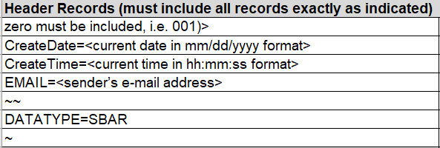
A Record-Header

Slide 17
Example of SBAR Reporting
A Record: Header
B Record: Incident

Slide 18
B Record: Incident Record
Collects the information on the overall incident
One B record per incident regardless of how many offenders, behaviors or supports are identified

Slide 19
B Record: Incident Record
9 Data Elements
Record Type (B)
Local Incident ID
Incident Division Number
Incident School Number
Date of Incident
Time of Incident
Location of Incident
Firearms Confiscated
Weapons Confiscated

Slide 20
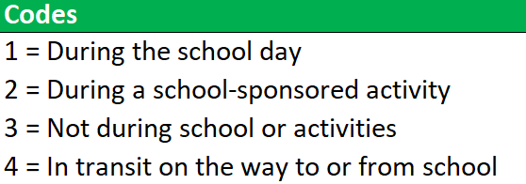
Time of Incident
Time the incident occurred

Slide 21
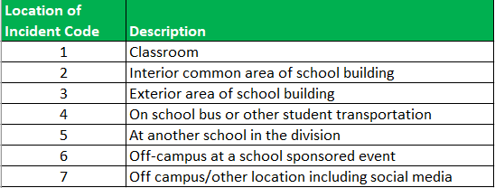
Location of Incident
Location of the incident

Slide 22
Firearms Confiscated
Number of Firearms confiscated
If Behavior Code is BSC24, BESO15, or BESO17 this field cannot be blank

Slide 23
Weapons Confiscated
Number of non-firearm weapons confiscated
If Behavior Code is BSC24, BESO15, or BESO17 this field cannot be blank

Slide 24
Example of SBAR Reporting
A Record: Header
B Record: Incident

Slide 25
Example of SBAR Reporting
C Record: Student 1 Behavior 1
A Record
B Record: Incident
C Record: Student 1 Behavior 2
C Record: Student 2
Behavior 1

Slide 26
C Record: Student Behavior Record
Collects the information on each student and each behavior
Every B (incident) record will have one or more C (student behavior) records
One or more student can have a C record for an incident
Each reportable behavior will have a C record

Slide 27
Example of SBAR Reporting
C Record: Student 1 Behavior 1
A Record
B Record: Incident
C Record: Student 1 Behavior 2
C Record: Student 2
Behavior 1

Slide 28
C Record: Student Behavior Record
10 Data Elements
Record Type (C)
Local Incident ID
State Testing Identifier (STI)
Behavior Code/Persistently Dangerous Code
Local Authorization Code/Other Explanation
Unknown Offender Type Code
Enrolled Division Number
Enrolled School Number
Aggravating Circumstances Flag
Law Enforcement Flag

Slide 29
Behavior Code Categories
Category A (BAP)
Behaviors that impede academic progress of the student or other students
Category B (BSO)
Behaviors related to school operations and interfere with the daily operation of school procedures
Category C (RB)
Behaviors that create a negative relationship between two or more members of the school community
Category D (BSC)
Behaviors of a safety concern that create unsafe conditions for students, staff, and/or visitors to the school.
Category E (BESO)
Behaviors that endanger self or others health, safety, or welfare of either the student or others in the school

Slide 30
Persistently Dangerous Incident Codes
The Persistently Dangerous Incident Code is used to identify student behaviors described in the Virginia’s Unsafe School Choice Option Policy required by the federal Every Student Succeeds Act of 2015.

Slide 31
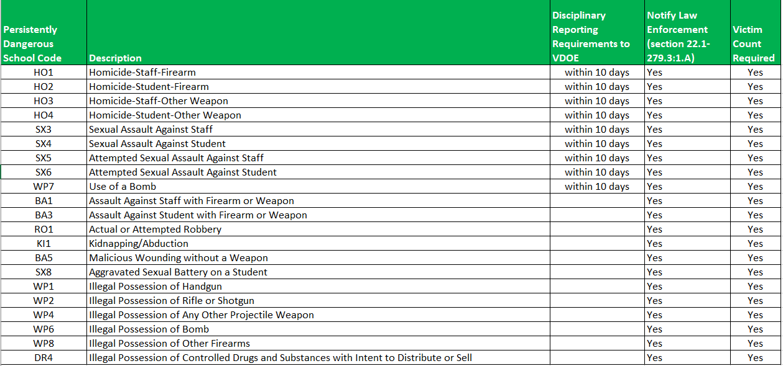
Persistently Dangerous Incident Codes

Slide 32
Local Authorization Code/Other Explanation
Established process for obtaining a Local Authorization Code for any behavior not identified in the existing behavior codes
This is to track behaviors that need codes, to prevent having too many codes, and to ensure accurate reporting
We will provide a follow up webinar on this process later in the year

Slide 33
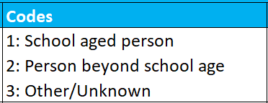
Unknown Offender Code
The type of offender if the offender is not a student within the division.

Slide 34
Aggravating Circumstances Flag
Three criteria
Resulted in a threat assessment determination of serious harm or credible threat of serious harm or
Pose an ongoing and unreasonable risk to school safety or
Be persistent and unresponsive to intervention

Slide 35
Law Enforcement Flag
Flag to identify if law enforcement was notified of this behavior

Slide 36
Example of SBAR Reporting
C Record: Student 1 Behavior 1
A Record
B Record: Incident
C Record: Student 1 Behavior 2
C Record: Student 2
Behavior 1

Slide 37
Example of SBAR Reporting
D Record: Student 1 Behavior 1
Response 1
C Record: Student 1 Behavior 1
D Record: Student 1 Behavior 1 Response 2
A Record
B Record: Incident
C Record: Student 1 Behavior 2
D Record: Student 1 Behavior 2 Response 1
C Record: Student 2
Behavior 1
D Record: Student 2 Behavior 1 Response 1

Slide 38
D Record: Administrative Response
Includes the response(s) to each Behavior of each Student in the Incident
There must be a minimum of one response per behavior
There can be multiple D records per student
There can be multiple D records per behavior

Slide 39
Example of SBAR Reporting
D Record: Student 1 Behavior 1
Response 1
C Record: Student 1 Behavior 1
D Record: Student 1 Behavior 1 Response 2
A Record
B Record: Incident
C Record: Student 1 Behavior 2
D Record: Student 1 Behavior 2 Response 1
C Record: Student 2
Behavior 1
D Record: Student 2 Behavior 1 Response 1

Slide 40
D Record: Administrative Response
10 data elements
Record Type (D)
Local Incident ID
State Testing Identifier (STI)
Behavior Code
Behavioral Intervention Code
Instructional Support Code
Disciplinary Sanction Code
Days Sanctioned
Alternative Placement Educational Agency
Alternative Placement School

Slide 41
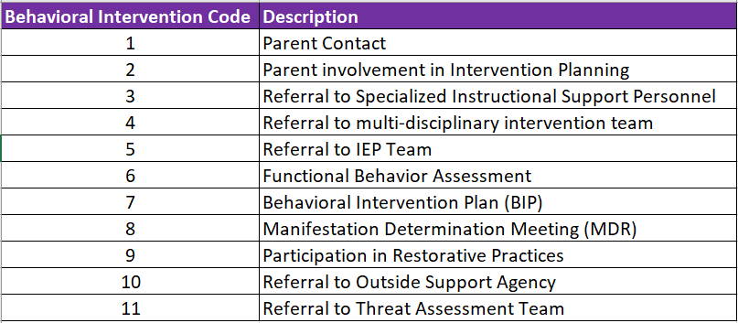
Behavioral Intervention Code
Specific intervention that addresses the specific student behavior

Slide 42
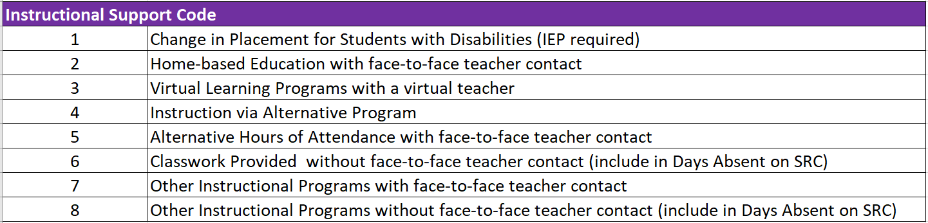
Instructional Support Code
Any instructional support provided to the student

Slide 43
Disciplinary Sanction Code
Disciplinary sanction given to a student for a behavior as related to the incident

Slide 44
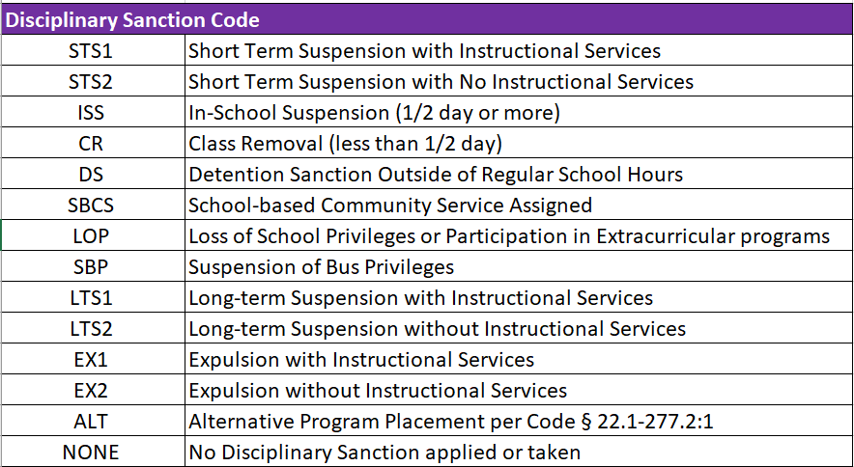
Disciplinary Sanction Code

Slide 45
Example of SBAR Reporting
D Record: Student 1 Behavior 1
Response 1
C Record: Student 1 Behavior 1
D Record: Student 1 Behavior 1 Response 2
A Record
B Record: Incident
C Record: Student 1 Behavior 2
D Record: Student 1 Behavior 2 Response 1
C Record: Student 2
Behavior 1
D Record: Student 2 Behavior 1 Response 1

Slide 46
Example of SBAR Reporting
D Record: Student 1 Behavior 1
Response 1
C Record: Student 1 Behavior 1
D Record: Student 1 Behavior 1 Response 2
A Record
B Record: Incident
C Record: Student 1 Behavior 2
D Record: Student 1 Behavior 2 Response 1
C Record: Student 2
Behavior 1
D Record: Student 2 Behavior 1 Response 1
E Record: Victims

Slide 47
E Record: Victims Record
E records are required for specific behavior codes and optional for all others
Only one E record for each qualifying B record
Refer to behavior code chart (coming soon)

Slide 48
E Record: Victims Record
7 data elements
Record type (E)
Local Incident ID
Student Victims
Staff Victims
Other Adult Victims
Other/Unknown Victims
Indeterminate Victims Flag

Slide 49
Example of SBAR Reporting
D Record: Student 1 Behavior 1
Response 1
C Record: Student 1 Behavior 1
D Record: Student 1 Behavior 1 Response 2
A Record
B Record: Incident
C Record: Student 1 Behavior 2
D Record: Student 1 Behavior 2 Response 1
C Record: Student 2
Behavior 1
D Record: Student 2 Behavior 1 Response 1
E Record: Victims

Slide 50
Tentative Timeline
2020-2021 School Year-Divisions implementing new Model Guidance (ongoing at LEA level)
Spring 2020 – Release SBAR data elements to divisions.
Fall 2020- SBAR informational website open with guidance, codes, and training
Winter 2020 – Divisions continue to submit discipline data using DCV with option to add SBAR behavior codes.
2020-2021- Quarterly Webinars (persistently dangerous and behaviors without a code)
July 16, 2021 – Final DCV submission closes.
October 1, 2021 – May 2022 - Pre-submission to SBAR is open.
October 1, 2021-Web form opens for reporting Persistently Dangerous Incidents
July 15, 2022 - SBAR data collection closes.
Fall 2022: SBAR Build-a-Table will be available

Slide 51
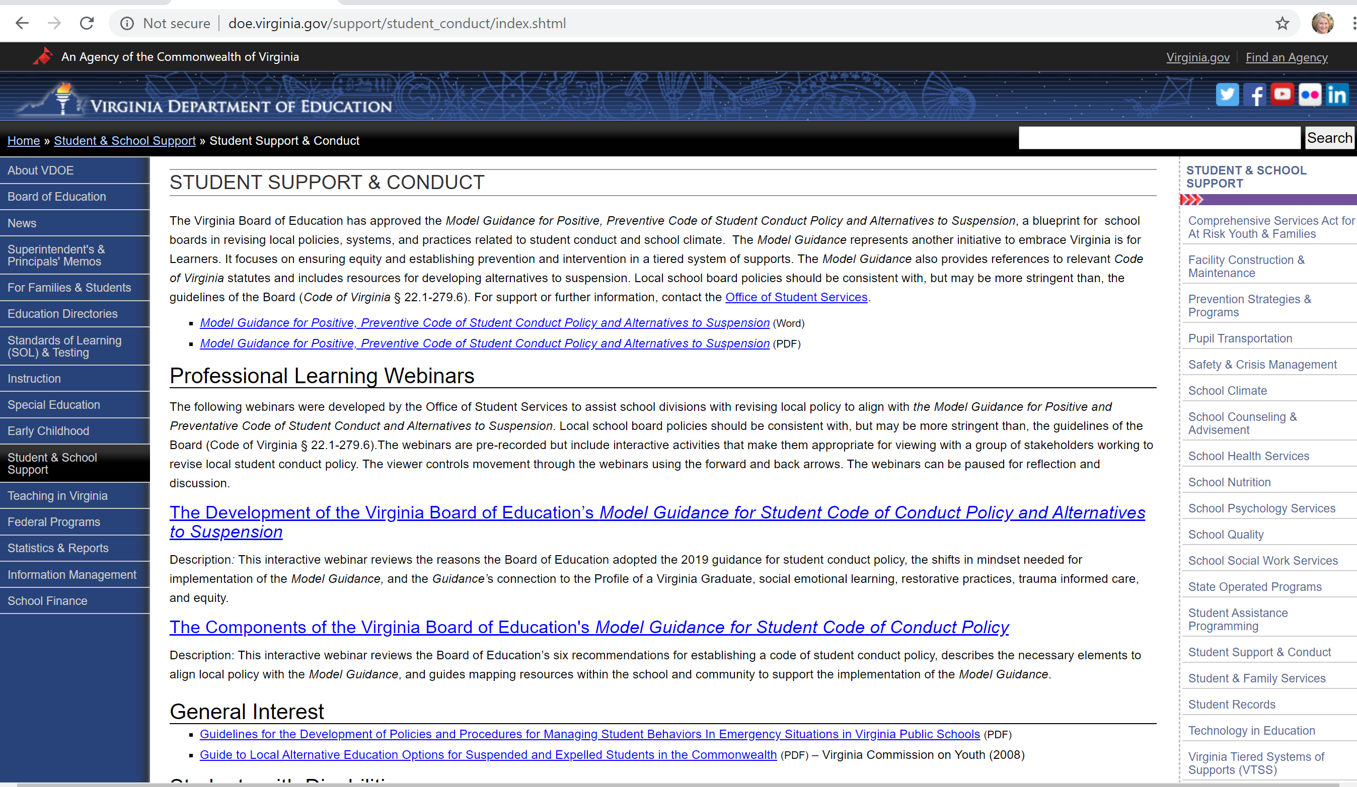

Slide 52
Contact Information
E-Mail:
ResultsHelp@doe.virginia.gov
Brittney.Kanard@doe.Virginia.gov
Rebecca.Kahila@doe.Virginia.gov
Susan.M.Williams@doe.virginia.gov
Phone:
(804) 225-3909

