Slide 1
Virtual Learning Professional Learning Series
VL Webinar 1: Virtual Learning in VA
Wednesday, November 17, 2021
3:00-4:00 p.m.

Slide 2




Presenters
Dr. Meg Foley
meg.foley@doe.virginia.gov
(804) 786-0877
Coordinator of Virtual Learning
Reginald Fox
reginald.fox@doe.virginia.gov
(804) 371-5663
Virtual Learning Specialist
Twitter: @VDOE_News Facebook: @VDOENews
#VAis4Learners #EdEquityVA

Slide 3
Virtual Learning in Virginia
To provide school divisions, schools, staff, and stakeholders with information related to virtual learning in Virginia with emphasis on policies, procedures, professional development, and implementation of virtual programs.
Discuss the MOP, School Divisions & Virtual Programs
The Partnerships: Roles & Responsibilities of Stakeholders
Policies & Procedures
Communication
Forum for MOP & School Divisions

Slide 4
Virtual Learning for schools and students (Virtual Learning HUB - Professional Development, Supports & Resources)

Slide 5
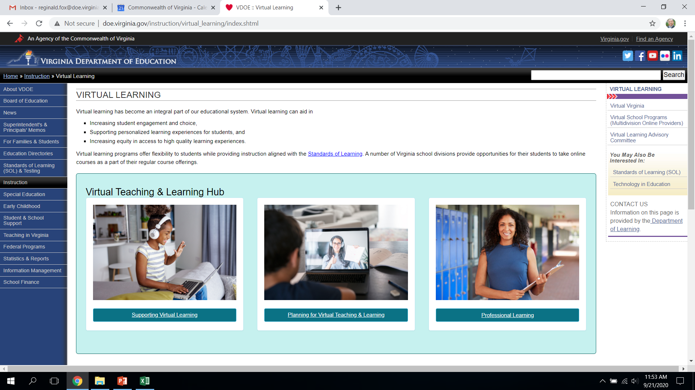
The Virtual Learning HUB

Slide 6



Virtual Learning in VA
Virtual VA (VVA)
Virginia public school divisions & Virtual Virginia partner together to ensure learners have access and opportunity that complement those available in the physical school.
Homeschool, Private School & Private Online Providers
Parents may choose to enroll in an approved homeschool program, private school, or online private provider of virtual courses.
Multidivision Online Providers (MOP)
As provided in § 22.1-212.23 et seq. , the Code of Virginia allows school divisions to offer online instruction to students using a private organization, educational institution or nonprofit virtual school organization that meets Board of Education approval criteria to operate as a MOP.

Slide 7
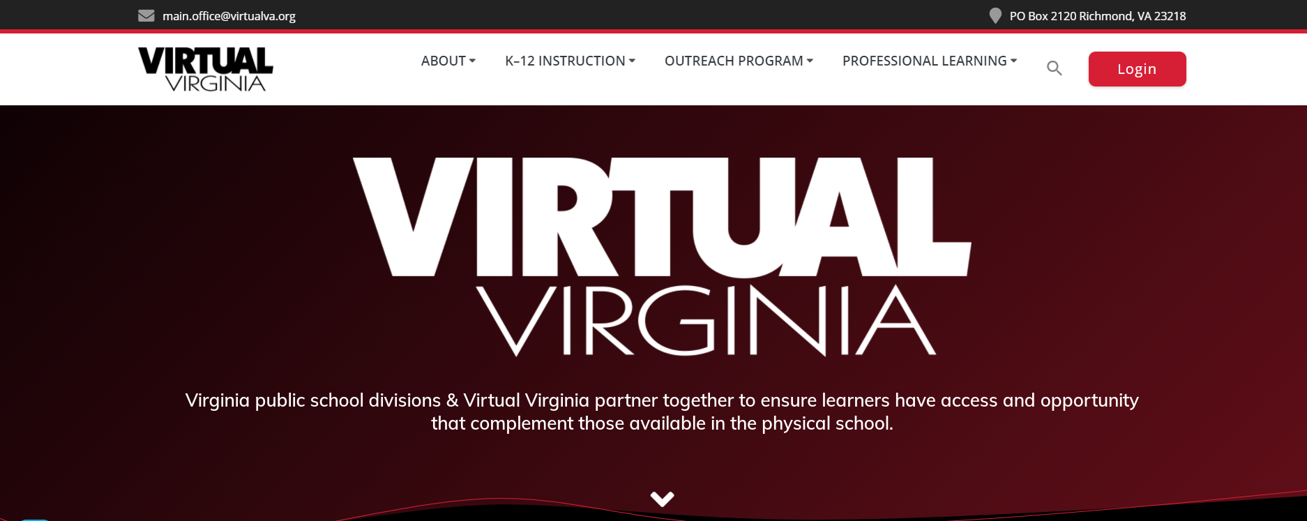
Virtual Learning in VA
Virtual VA (VVA)
Virginia public school divisions & Virtual Virginia partner together to ensure learners have access and opportunity that complement those available in the physical school.
https://virtualvirginia.instructuremedia.com/embed/56502135-9a20-4998-8e78-bbe3d747f2aa

Slide 8
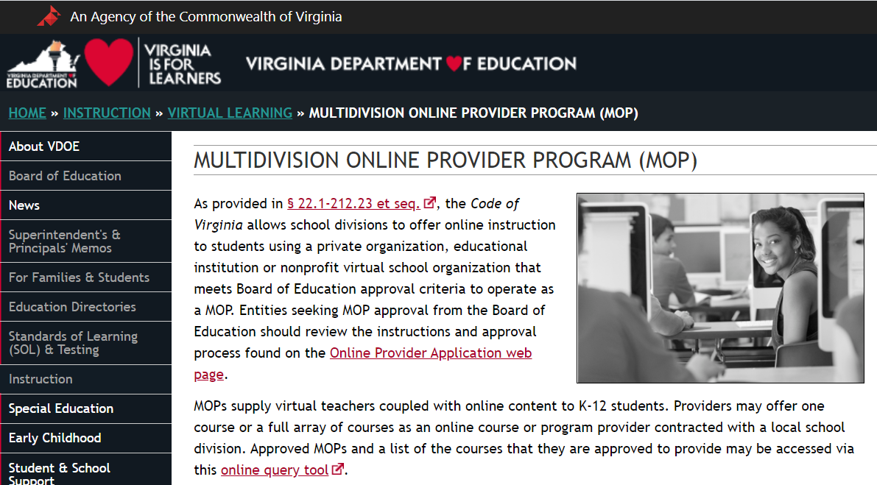
Virtual Learning in VA
Multidivision Online Providers (MOP)
A multidivision online provider is:
a private or nonprofit organization that enters into a contract with a local school board to provide online courses or programs through that school board to students who reside in Virginia both within and outside the geographical boundaries of that school division
a private or nonprofit organization that enters into contracts with multiple local school boards to provide online courses or programs to students in grades K through 12 through those school boards
a local school board that provides online courses or programs to students who reside in Virginia but outside the geographical boundaries of that school division

Slide 9
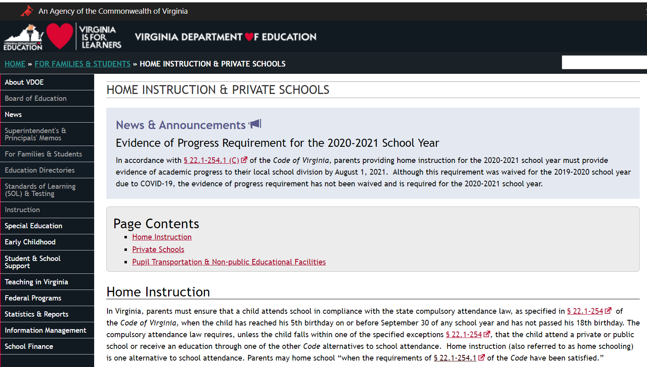
Virtual Learning in VA
Homeschool, Private School & Private Online Providers
Parents may choose to enroll in an approved homeschool program, private school, or online private provider of virtual courses.

Slide 10
Partnerships: Key Responsibilities for Stakeholders

Slide 11

Local School Board
Contract with approved multidivision online provider.
Ensure school division meets Standards of Accreditation and other requirements.
Make agreements with other local school boards regarding participation of non-resident students in virtual school programs.

Slide 12
School Division Administration
Provide information about services offered through the division’s contracts with multidivision online provider.
Ensure students take courses that address their specific needs, including any provisions required under the individualized education program (IEP), 504 Plan, and other specialized services.
Gather data from multidivision online provider regarding student progress and participation, communicate information to parents, and report accurately through regular channels to VDOE.

Slide 13

Parental Engagement
Students participate in virtual course(s) offered by a multidivision online provider with approval by the school division.
Monitor student progress through communication with student, school division, and multidivision online provider.
Notify school division and multidivision online provider if student’s status changes (if student moves, if student discontinues course or program, or if there are changes in serving student).
Provide feedback on services to multidivision online provider and school division.

Slide 14
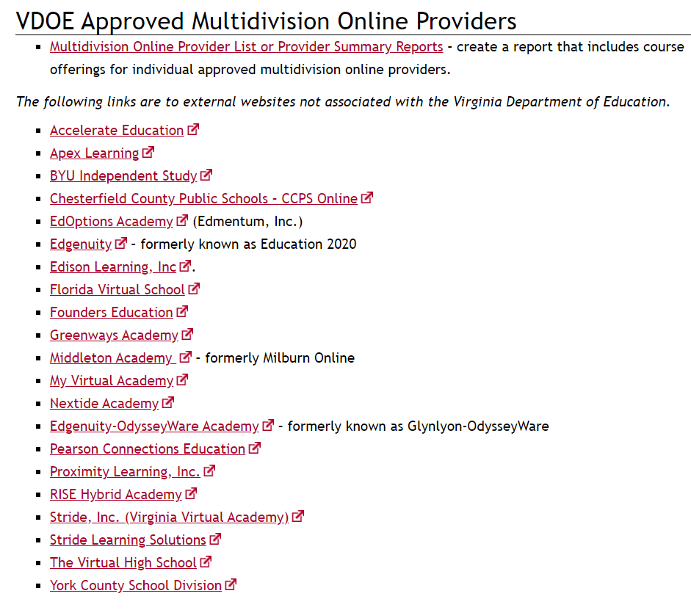
MOP
Provide information as specified in application to VDOE.
Align courses to Virginia SOL & CTE competencies.
Once approved, contract with local school boards.
Provide services as stipulated in contracting with school divisions.
Provide information to VDOE as requested.
Communicate frequently with school divisions and parents about student progress and participation.

Slide 15
What questions do you have about basic responsibilities?
Dr. Meg Foley
meg.foley@doe.virginia.gov
(804) 786-0877
Coordinator of Virtual Learning
Reginald Fox
reginald.fox@doe.virginia.gov
(804) 371-5663
Virtual Learning Specialist
Twitter: @VDOE_News Facebook: @VDOENews
#VAis4Learners #EdEquityVA

Slide 16
Policies & Procedures

Slide 17

Supporting Virtual Learning
School divisions are encouraged to ensure representation of diverse experiences and perspectives including, but not limited to racial, ethnic, language, religions, and gender groups and inclusion of content that represents, validates, and affirms diverse groups from different rings of culture.

Slide 18

Supporting Virtual Learning – Enrollment & Records
Ensure that reporting and data transmission policies and measures are implemented to ensure compliance with state and federal privacy laws.
Communicate criteria for enrollment.
Allow flexibility for transfer students.
Provide a process for the transfer of records for all students.
Establish communication between MOP & school division.
Keep parents informed.

Slide 19
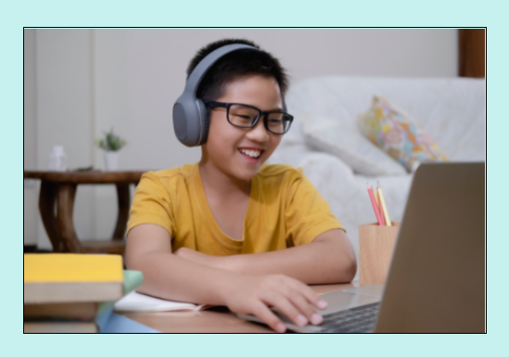
Supporting Virtual Learning – Students with Disabilities
School divisions must comply with all federal laws and state regulations governing the education of all public school students. While the responsible school division is required to provide services and counseling for special populations, including students with disabilities, English Learners, gifted, minorities, and/or economically disadvantaged, the provider must work collaboratively with the school division in order to provide these services.

Slide 20
Supporting Virtual Learning – Students with Disabilities
Schools should identify students with disabilities and share IEP, 504 Plan, or other related academic or support services required.
MOP will comply with requirements and accommodations outlined in IEP or 504 Plan.
Both school and MOP will have necessary communication to ensure student success.
Encourage communication between teachers, students and parents.

Slide 21
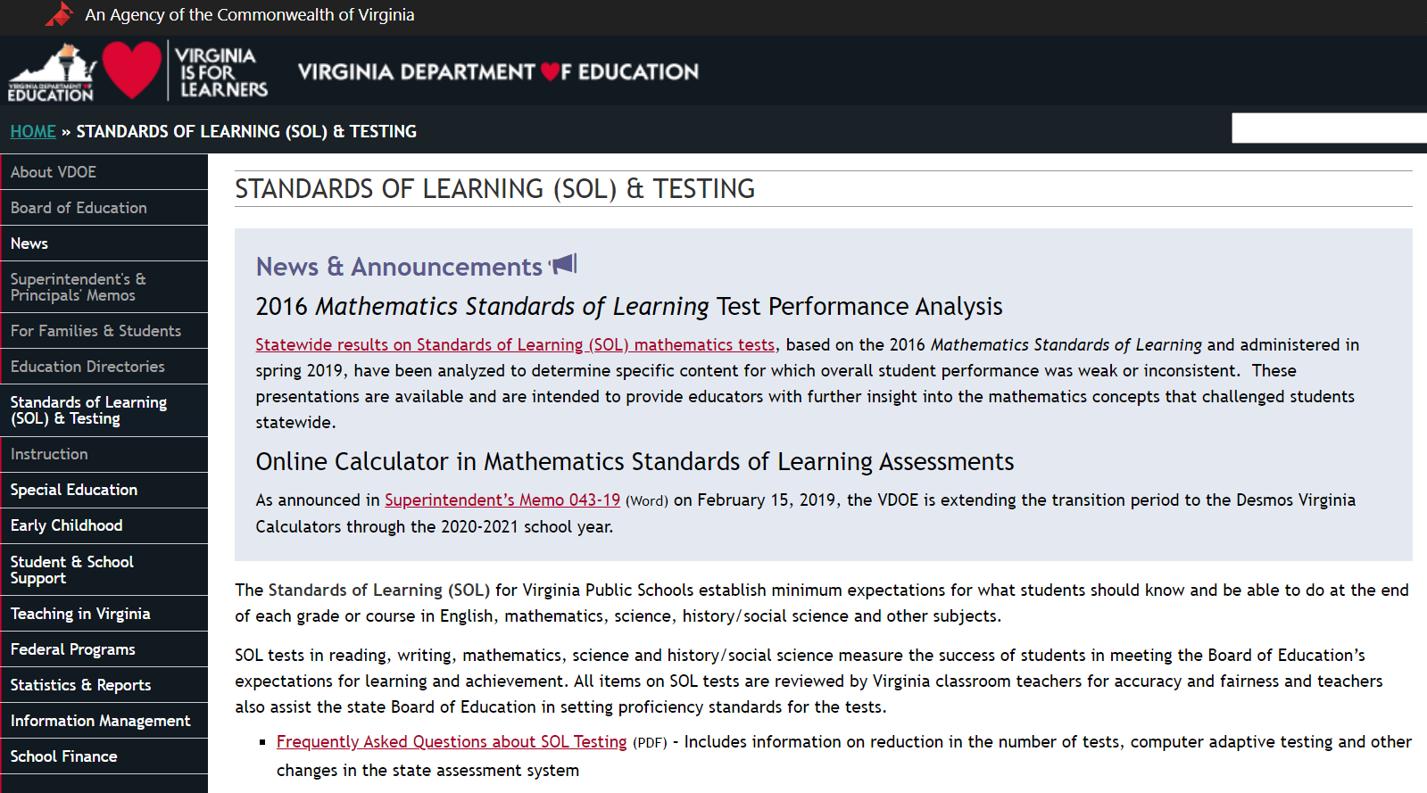
Supporting Virtual Learning – Required Testing
Ensure the management and oversight of Virginia Standards of Learning test administration by school division and student participation rates in the Virginia Standards of Learning tests
Report student participation rates on standardized tests, and other types specialized testing.

Slide 22

Supporting Virtual Learning – Communication
Both MOP & school divisions should include appropriate and sufficient communication that ensures the success of all virtual students.
Enrollment process and records
Procedures and expectations required
Orientation for all stakeholders (school staff, mentors, students, and parents)
Student monitoring and student progress
Reporting of progress and grades; an established time to review appropriate with students and parents
Use of surveys and other means of communication to gather feedback

Slide 23
What questions do you have about policies and procedures? What suggestions do you have to help us facilitate and communicate on a regular basis with stakeholders?
Dr. Meg Foley
meg.foley@doe.virginia.gov
(804) 786-0877
Coordinator of Virtual Learning
Reginald Fox
reginald.fox@doe.virginia.gov
(804) 371-5663
Virtual Learning Specialist
Twitter: @VDOE_News Facebook: @VDOENews
#VAis4Learners #EdEquityVA

Slide 24
Forum for MOP & School Divisions (communicating with stakeholders)

Slide 25
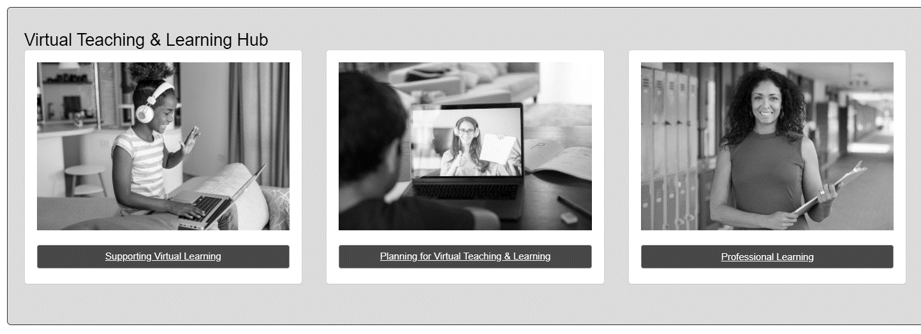
MOP & LEA Forum
We want to expand our professional learning area of the Virtual Learning HUB to include a professional learning community.
Identify appropriate staff with the MOP & school divisions who work closely with the implementation of virtual learning.
What would work best for you? What form of communication would you like to have?

Slide 26
Thank you for participating!
Potential Future Discussion Topics Transfer enrollment process Students remain in home school division with all services Teacher Licensure Teacher of record for full-time and part-time MOP; course enrollment Communication strategies for MOP, school staff, parents/students Monitoring process and student progress Reporting EIM - Master Schedule Collection EIM - Student Record Collection Closing out the year Surveys Final reporting Monitoring Report
Dr. Meg Foley
meg.foley@doe.virginia.gov
(804) 786-0877
Coordinator of Virtual Learning
Reginald Fox
reginald.fox@doe.virginia.gov
(804) 371-5663
Virtual Learning Specialist

